Slide 1
Part 1: Information Retrieval

Slide 2
1. Information Retrieval - Overview
1.1 Introduction to Information Retrieval
1.2 Basic Information Retrieval
1.2.1 Text-Based Information Retrieval
1.2.2 Boolean Retrieval
1.2.3 Vector Space Retrieval
1.2.4 Evaluating Information Retrieval
1.2.4.1 Precision-Recall
1.2.4.2 Ranked Retrieval
1.2.5 Probabilistic Information Retrieval
1.2.6 Query Expansion
1.2.6.1 User Relevance Feedback
1.2.6.2 Global Query Expansion
1.3 Embedding Techniques
1.3.1 Latent Semantic Indexing
1.3.2 Latent Dirichlet Allocation
1.3.3 Word Embeddings – skipgram, CBOW
1.3.4 Fasttext
1.3.5 Glove

Slide 3
1.1 introduction to Information Retrieval

Slide 4
What is Information Retrieval?
Information retrieval (IR) is the task of finding in a large collection of documents those that satisfy the information needs of a user
Examples
Searching documents in a library
Searching the Web
Notes:
Information retrieval deals with the problem of matching information needs of human users with information provided in large document collections. Important aspects of this definition are:
Documents are largely unstructured data; documents can be based on different media, including text, images, videos
Document collections are generally large, with the Web being a prime example of a very large document collection
Information needs are user and context dependent; there exists no formal (mathematical) definition of the information retrieval task

Slide 5
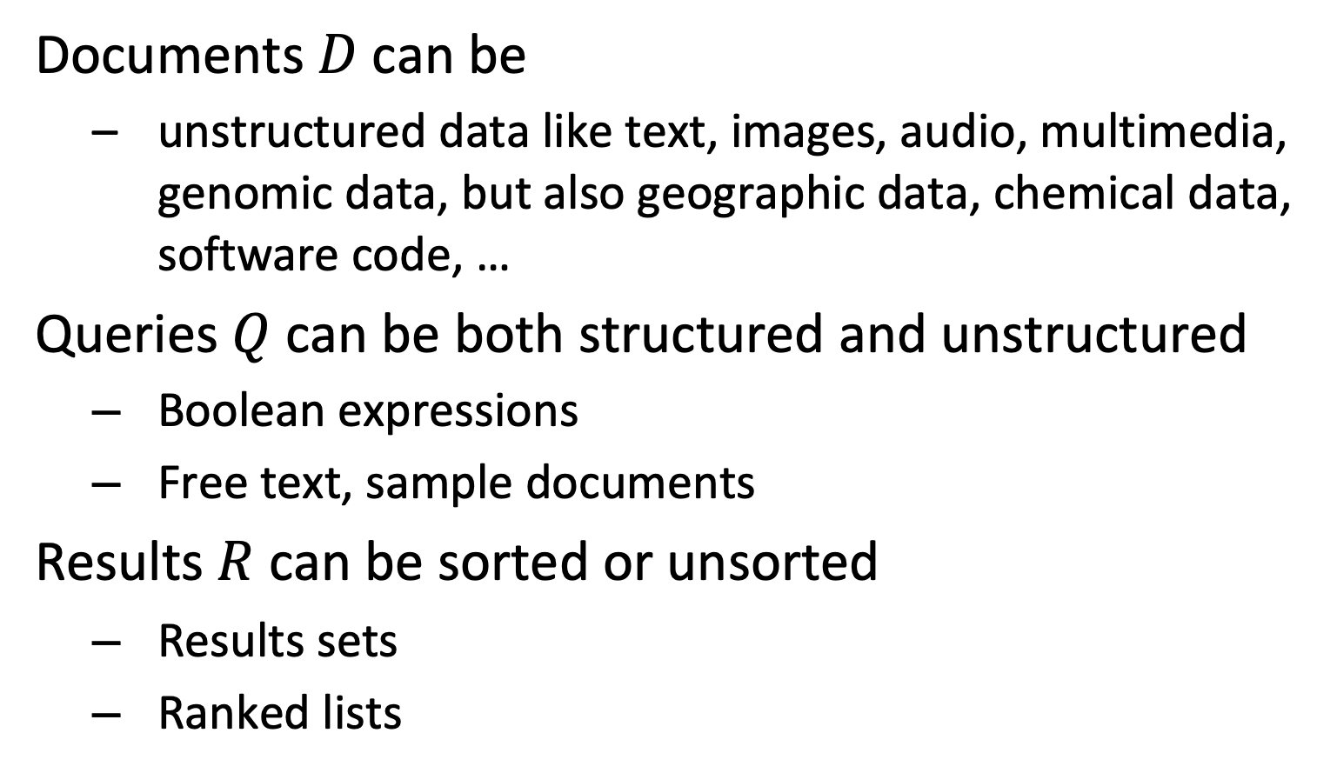
Different Types of Information Retrieval
Documents $D$can be
unstructured data like text, images, audio, multimedia, genomic data, but also geographic data, chemical data, software code, …
Queries $Q$ can be both structured and unstructured
Boolean expressions
Free text, sample documents
Results $R$ can be sorted or unsorted
Results sets
Ranked lists
Notes:
Information retrieval addresses search in many types of (mostly unstructured) data. The queries can be based on formal languages for retrieval, on unstructured queries, such as text queries, are sample documents that represent the search interest. Results can be both ranked or not ranked.

Slide 6
Basic Information Retrieval Approach
information items (unstructured) content
retrieval system: efficiency
feature extraction
retrieval model: relevance
structured document representation
ranked/ binary
result
similarity ?
structured query representation
matching
query formulation
information need
(unstructured) query
Notes:
An information retrieval system must deal with the following tasks:
Generating structured representations of information items: this process is called feature extraction and can include simple tasks, such as extracting words from a text as well as complex methods, e.g., for image or video analysis.
Generating structured representations of information needs: often this task is solved by providing users with a query language and leave the formulation of structured queries to them. This is the case, for example, for simple keyword-based query languages, as used in Web search engines. Some information retrieval systems also support the user in the query formulation, e.g., through visual interfaces.
Matching of information needs with information items: this is the algorithmic task of computing similarity of information items and retrieval queries. At the heart of this step is the information retrieval model. Similarity measures on the structured representations of queries and documents are used to model relevance of information for users. As a result, a selection of relevant information items or a ranked result can be presented to the user.
Since information retrieval systems deal usually with large information collections and/or large user communities, the efficiency of the implementation of an information retrieval system is crucial. This imposes fundamental constraints on the retrieval model. Retrieval models that would capture relevance very well, but are computationally prohibitively expensive, are not suitable for an information retrieval system.

Slide 7
Example: Text Retrieval
Web documents text content
information retrieval system: Google,
Bing etc.
feature extraction:
terms, words
retrieval model: Boolean, Vector etc.
example: "web retrieval"
ranked list of Web documents
similarity ?
example:
"web information retrieval"
matching: occurrence of
query terms in
document
query formulation:
keywords
Web search
Notes:
The most popular information retrieval systems today are Web search engines. To a large degree, they are text retrieval systems, since they exploit mainly the textual content of Web documents for retrieval. However, current Web search engines also exploit many other features of documents, such as link information or image content, and personal features of the users. The three tasks of a Web search engine for retrieval are:
extracting the textual features, which are the words or terms that occur in the documents. We assume that the web search engine has already collected the documents from the Web using a Web crawler.
support the formulation of textual queries. This is usually done by allowing the entry of keywords through Web forms.
computing the similarity of documents with the query and producing from that a ranked result. Standard methods for computing similarity Boolean retrieval and vector space retrieval. We will introduce these methods in detail later in this lecture.

Slide 8
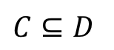
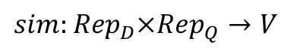

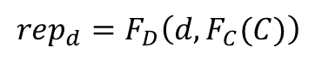
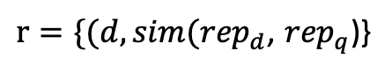
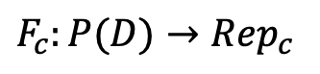
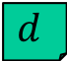
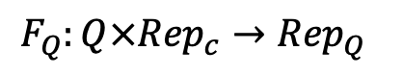

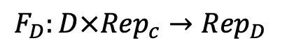
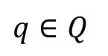
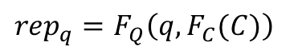
Formally $IR:P(D)×Q→R$
$$C⊆D$$
$$F_{c}:P(D)→{Rep}_{c}$$
The representation depends on the individual document as well as on the features of collection $C$!
$$F_{D}:D×{Rep}_{c}→{Rep}_{D}$$
$$d$$
$${{rep}_{d}=F}_{D}\left(d,F_{C}(C)\right)$$
$r=\{(d,sim({rep}_{d}$, ${rep}_{q}$)}
$$sim:{{Rep}_{D}×Rep}_{Q}→V$$
$${{rep}_{q}=F}_{Q}\left(q,F_{C}(C)\right)$$
$$F_{Q}:Q×{Rep}_{c}→{Rep}_{Q}$$
The similarity function can be computed
for each document individually!
$$q∈Q$$
Notes:
Here we provide a more formal description of how information retrieval models work in general. A first important observation is that the result depends not only on the properties of the query, but also on (statistical) properties of the document collection C, a subset of all possible documents D. So, formally, the information retrieval task can be described as the computation of a function $IR:P(D)×Q→R$ that for a given collection of documents $C⊆D$ and a query $q∈Q$ computes a result $r∈R$. In information retrieval features are generated from the query Q, each document d and the document collection C. This is represented by the feature extraction functions $F_{c}$, $F_{D}$ and $F_{Q}$ that produce a representation for each document and query, as well as features that are related to the collection as a whole ($F_{C}(C)$). Those representations are used to compute the similarity between a document and query for each document individually. The collection features need to be extracted only once and stay the same for all similarity computations. This reduces overall the complexity of the similarity computation.

Slide 9
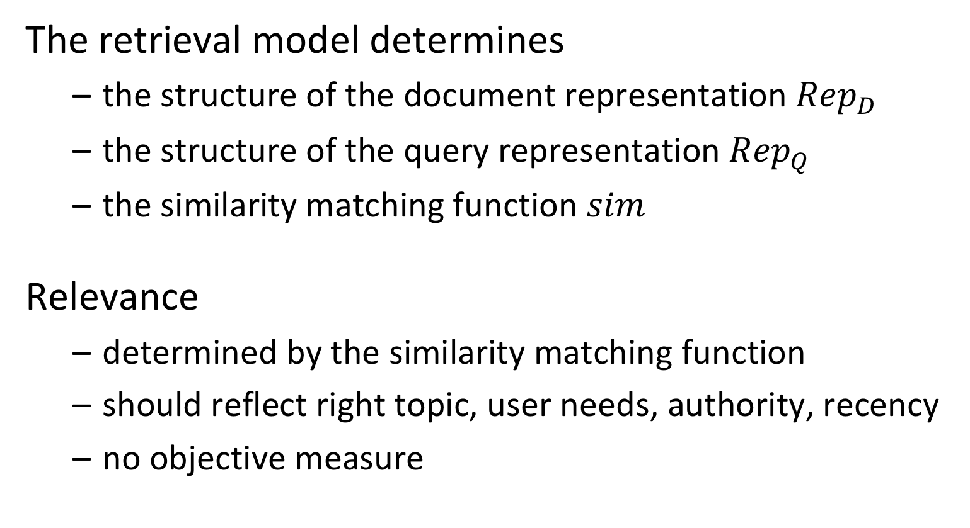
Retrieval Model
The retrieval model determines
the structure of the document representation ${Rep}_{D}$
the structure of the query representation ${Rep}_{Q}$
the similarity matching function $sim$
Relevance
determined by the similarity matching function
should reflect right topic, user needs, authority, recency
no objective measure
Notes:
The heart of an information retrieval system is its retrieval model. The retrieval model is used to capture the meaning of documents and queries and determines from that the relevance of documents with respect to queries. Although there exist different intuitive notions of what determines relevance one must keep clearly in mind that it is not an objective measure and highly context-dependent.

Slide 10
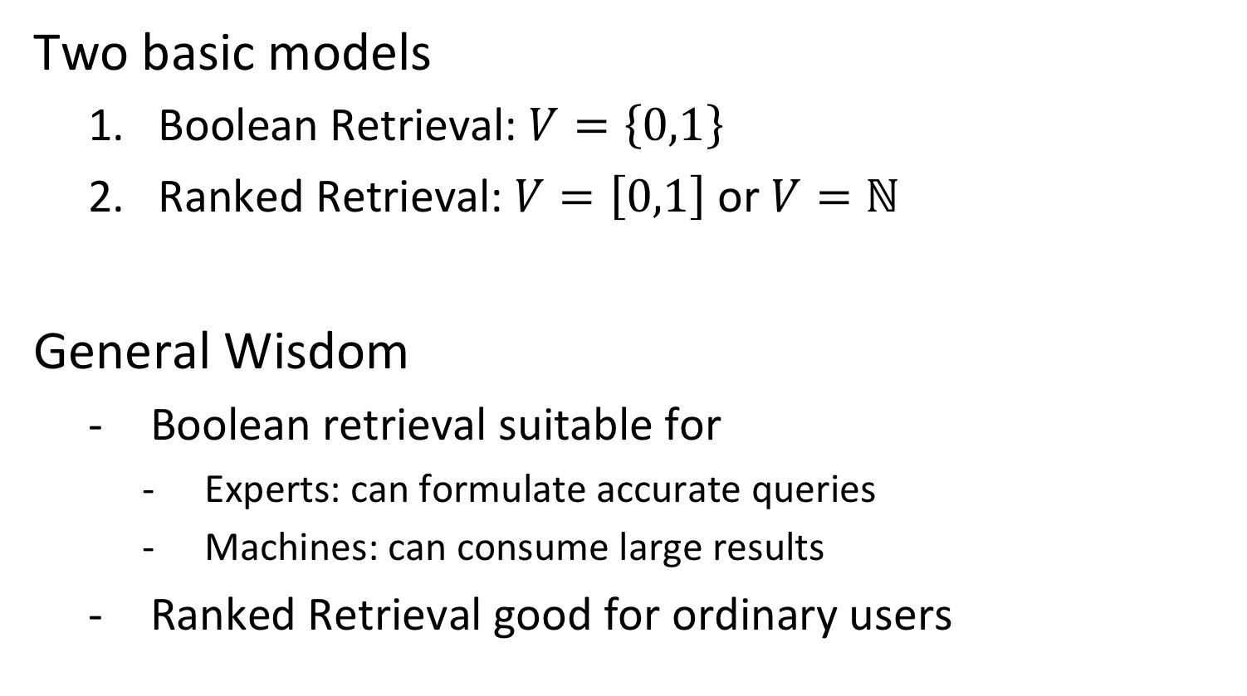
What does the Similarity Function compute?
Two basic models
Boolean Retrieval: $V=\left\{0,1\right\}$
Ranked Retrieval: $V=\left[0,1\right]$ or $V=ℕ$
General Wisdom
Boolean retrieval suitable for
Experts: can formulate accurate queries
Machines: can consume large results
Ranked Retrieval good for ordinary users
Notes:
There exist two basic types of results an information retrieval can produce. In Boolean retrieval the system returns a set of results. The main issue with this approach is that it is in general very difficult to formulate a query that produces a reasonably sized result set, that is not too large and not too small or empty. This is called sometimes the “feast-or-famine” problem. In contrast, ranked retrieval allows to to produce a list of result that is sorted by relevance. We may distinguish further whether scores are returned ($V=\left[0,1\right])$ which allows to assess the relative relevance of different results based on the scores, or whether simply a ranked list is returned ($V=ℕ$). The most common models return score values.

Slide 11
Information Filtering
filtering system: efficiency
retrieval model: relevance
information item content
feature extraction
structured document representation
similarity ?
disseminate item if relevant
structured query representation
matching
query profile
information
needs
Notes:
Information retrieval is also used to describe other tasks than document search. For example, the roles of documents and queries can be swapped in an information retrieval system. As a result, one obtains an information filtering system. Information filtering systems can be based on the same retrieval models as standard information retrieval systems for ad-hoc query access.

Slide 12
Information Retrieval and Browsing
Retrieval
Produce a ranked result from a user request
Interpretation of the information by the system
Browsing
Let the user navigate in the information set
Relevance feedback by the human
Retrieval
?
Browsing
Notes:
Information retrieval is usually closely connected to the task of browsing. Browsing is the explorative access by users to large document collections. By browsing a user implicitly specifies his/her information needs through selection of documents. This feedback can be used by an information retrieval system in order to improve its query representation and thus the retrieval result. One example of such an approach we will see when introducing relevance feedback. On the other hand, results returned by information retrieval systems are usually large, and therefore browsing is needed by users in order to explore the results. Both activities, retrieval and browsing thus can be combined into an iterative process. We will present methods for obtaining relevance feedback in the following.

Slide 13
Other tasks
In a more general sense Information Retrieval is used for a number of different types of tasks, such as
Information filtering
Document summarization
Question answering
Recommendation
Document classification
Notes:
There are a number of other types of tasks performed on large document collections that are associated with the field of information retrieval.

Slide 14
IR is an Information Management Task
model M
Model Usage (Inference): given a model, perform the task
Retrieve result documents for a query
Model Building (Learning): given documents, find a model
In IR the model is often based on simple statistics on the data
data
Notes:
Information retrieval is a classical information management tasks. It implies model building, by creating representations of documents and queries, and model usage by performing efficient retrieval of search results from large document collections.

Slide 15
1.2 basic information retrieval

Slide 16
1.2.1 Text-based Information Retrieval
Most of the information needs and content are expressed in natural language
Library and document management systems
Web Search Engines
Basic approach: use the words that occur in a text as features for the interpretation of the content
This is called the "full text” or “bag of words” retrieval approach
Ignore grammar, meaning etc.
Simplification that has proven successful
Document structure, layout and metadata may be considered additionally (e.g., PageRank/Google)
Notes:
Traditionally, information retrieval has been concerned with the problem of retrieving information from large bodies of documents with mostly textual content, as they where typically found in library and document management systems. The problems addressed were classification and categorization of documents, systems and languages for retrieval, user interfaces and visualization. The area was perceived as being one of narrow interest for a highly specialized user community, mainly librarians. The advent of the WWW changed this perception completely, as the web is a universal collection of documents with universal access.
Since nowadays a large quantity of the document content is still available in textual form, text retrieval is an important area of information retrieval. Natural language text carries a lot of meaning which is still hard to capture fully, and which has not necessarily to be captured fully to perform an information retrieval task. Therefore, information retrieval systems are based on strongly simplified models of text, ignoring most of the grammatical structure of text and reducing texts essentially to the terms they contain. This approach is called full text retrieval and is a simplification that has proven to be very successful.

Slide 17
Architecture of Text Retrieval Systems
User
Interface
Text
user need
Text
1. feature extraction
Text Operations
query repr.
document repr.
Query
Operations
DB Manager
Module
Indexing
user feedback
query
inverted file
Searching
Index
retrieved docs
3. efficient data access
Text
Database
Ranking
ranked docs
2. ranking system
Notes:
This figure shows the basic architecture of a text retrieval system, with its different functional components. We can distinguish three main components:
the feature extraction component: it performs text processing to transform queries and text documents into a keyword-based representation
the ranking system: it implements the retrieval model. In a first step user queries are potentially modified (if user relevance feedback is used), then the documents required for computing the result are retrieved from the database and finally similarity values are computed according to the retrieval model in order to compute the ranked result.
the data access system: it supports the ranking system by efficiently retrieving documents containing specific keywords from large document collections. A standard technique to implement this component is inverted files.
In addition, we have two interfaces, one with the user for query input and result output, and with a data management systems for handling the text database.

Slide 18
Pre-Processing Text for Text Retrieval
Feature Extraction
Tokens
Manual
indexing
Docs
stopwords
stemming
Structure
Layout
Metadata
Structured
data
Full text
Index terms
Notes:
In full text retrieval each document is represented by a set of representative keywords or index terms. An index term is a document word useful for capturing the document's main topics. Often, index terms are only nouns, because nouns carry meaning by themselves, whereas verbs express relationships between words. These relationships are more difficult to extract.
When using words as text features, the standard sequence of preprocessing steps is the following: first, the document structure, e.g., from XML OR HTML, is extracted and if required stored for further processing. The remaining text is stripped of special characters, producing the full text of the document as a sequence of tokens. Then very frequent words which are not useful for retrieval, so-called "stopwords", are eliminated (e.g., in English words such as "a", "and" etc.). As the same word can occur in natural language in different forms, usually stemming is used: Stemming eliminates grammatical variations of the same word by reducing it to a word root, e.g., the words connecting, connection, connections would be reduced to the same "stem" connect. This step can be followed by a manual intervention, where human curators can select or add index terms based on their understanding of the semantics of the document. The result of the process is a set of index terms which represents the document.

Slide 19
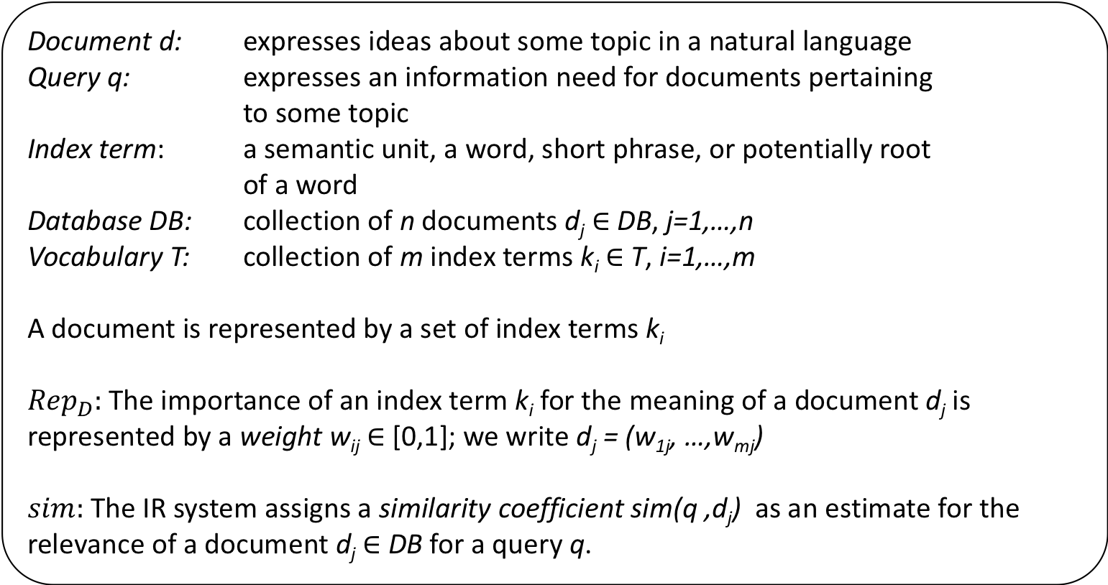
Text Retrieval - Basic Concepts and Notations
Document d: expresses ideas about some topic in a natural language
Query q: expresses an information need for documents pertaining to some topic
Index term: a semantic unit, a word, short phrase, or potentially root of a word
Database DB: collection of n documents d_{j} $∈$ DB, j=1,…,n
Vocabulary T: collection of m index terms k_{i} $∈$ T, i=1,…,m
A document is represented by a set of index terms k_{i}
${Rep}_{D}:$The importance of an index term k_{i} for the meaning of a document d_{j} is represented by a weight w_{ij} $∈$ [0,1]; we write d_{j} = (w_{1j}, …,w_{mj})
$sim:$The IR system assigns a similarity coefficient sim(q ,d_{j}) as an estimate for the relevance of a document d_{j} $∈$ DB for a query q.
Notes:
We introduce the terminology we will use in the following for describing text retrieval systems. Note that the method of how specific weights are assigned to an index term with respect to a document and of how similarity coefficients are computed are part of the specification of a text retrieval model.

Slide 20
Example: Documents
B1 A Course on Integral Equations
B2 Attractors for Semigroups and Evolution Equations
B3 Automatic Differentiation of Algorithms: Theory, Implementation, and Application
B4 Geometrical Aspects of Partial Differential Equations
B5 Ideals, Varieties, and Algorithms: An Introduction to Computational Algebraic Geometry and Commutative Algebra
B6 Introduction to Hamiltonian Dynamical Systems and the N-Body Problem
B7 Knapsack Problems: Algorithms and Computer Implementations
B8 Methods of Solving Singular Systems of Ordinary Differential Equations
B9 Nonlinear Systems
B10 Ordinary Differential Equations
B11 Oscillation Theory for Neutral Differential Equations with Delay
B12 Oscillation Theory of Delay Differential Equations
B13 Pseudodifferential Operators and Nonlinear Partial Differential Equations
B14 Sinc Methods for Quadrature and Differential Equations
B15 Stability of Stochastic Differential Equations with Respect to Semi-Martingales
B16 The Boundary Integral Approach to Static and Dynamic Contact Problems
B17 The Double Mellin-Barnes Type Integrals and Their Applications to Convolution Theory
Notes:
This is an example of a (simple) document collection that we will use in the following as running example.

Slide 21
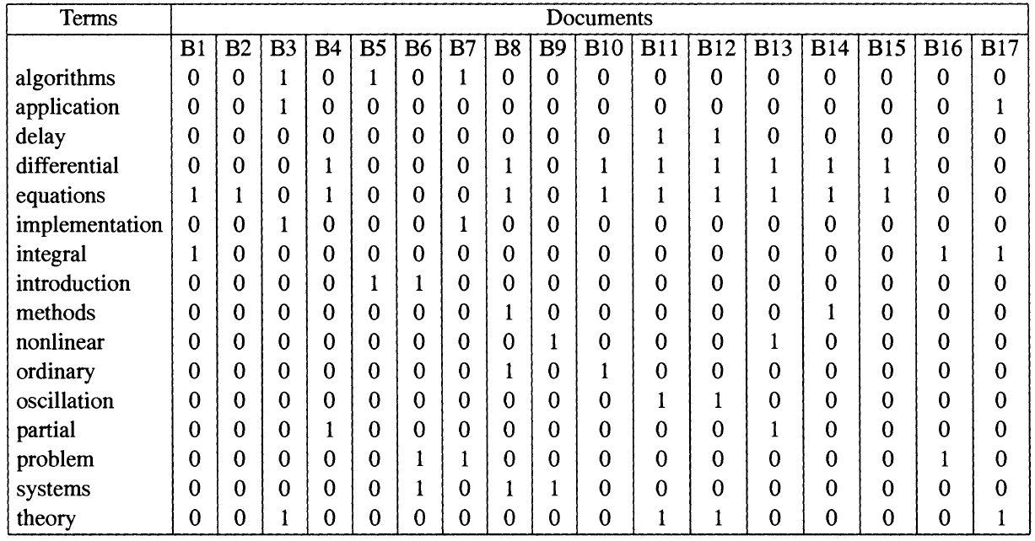
Term-Document Matrix
Matrix of weights w_{ij}
This example
Vocabulary (contains only terms that occur multiple times, no stop words)
all weights are set to 1 (equal importance)
Notes:
In text retrieval we represent the relationship between the index terms and the documents in a term-document matrix. In this example only a selected vocabulary is used for retrieval, consisting of all index terms that occur in more than one document and only weights of 1 are assigned, indicating that the term occurs in the document.

Slide 22
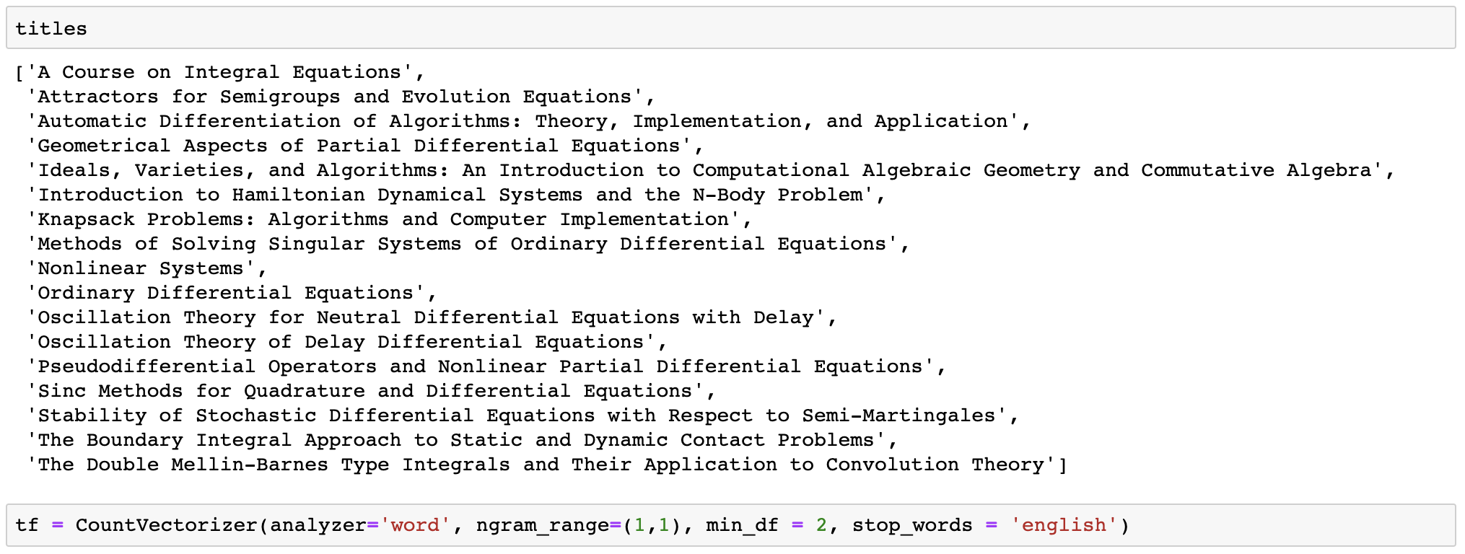
Implementation in Python
Notes:
Python provides the main functions that we will introduce formally, in the form of libraries. So in most cases a direct implementation of algorithms is no more required.
We will illustrate of how some of the core concepts we introduce, are represented in Python.

Slide 23
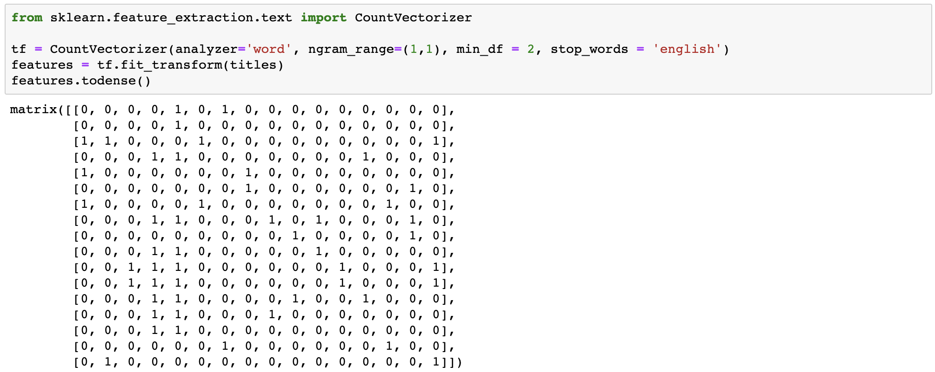
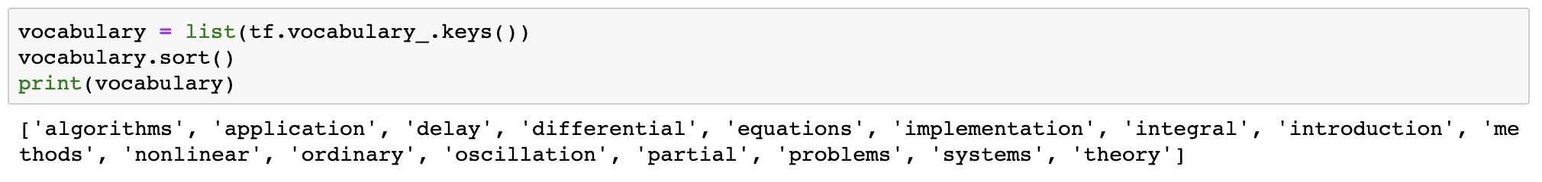
Implementation in Python

Slide 24
A retrieval model attempts to capture …
the interface by which a user is accessing information
the importance a user gives to a piece of information for a query
the formal correctness of a query formulation by user
the structure by which a document is organised

Slide 25
Full-text retrieval refers to the fact that …
the document text is grammatically fully analyzed for indexing
queries can be formulated as texts
all words of a text are considered as potential index terms
grammatical variations of a word are considered as the same index terms

Slide 26
The entries of a term-document matrix indicate …
how many relevant terms a document contains
how frequent a term is in a given document
how relevant a term is for a given document
which terms occur in a document collection

Slide 27
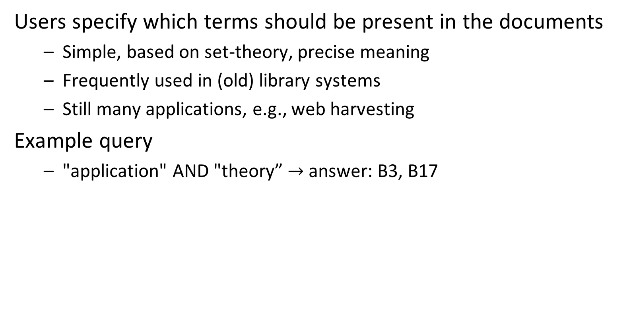
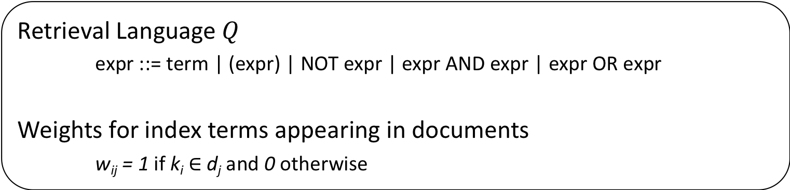
1.2.2 Boolean Retrieval
Users specify which terms should be present in the documents
Simple, based on set-theory, precise meaning
Frequently used in (old) library systems
Still many applications, e.g., web harvesting
Example query
"application" AND "theory” $→$ answer: B3, B17
Retrieval Language $Q$
expr ::= term | (expr) | NOT expr | expr AND expr | expr OR expr
Weights for index terms appearing in documents
w_{ij} = 1 if k_{i} $∈$ d_{j} and 0 otherwise
Notes:
Early information retrieval systems (as well as many search systems in use today, such as integrated search tools in operating systems, like spotlight and windows search) use the Boolean retrieval model. This model is in fact comparable to database querying, as requests are specified as first order logical expressions. Term weights are set to 1 when a term occurs in a document, as shown in the term-document matrix previously.

Slide 28
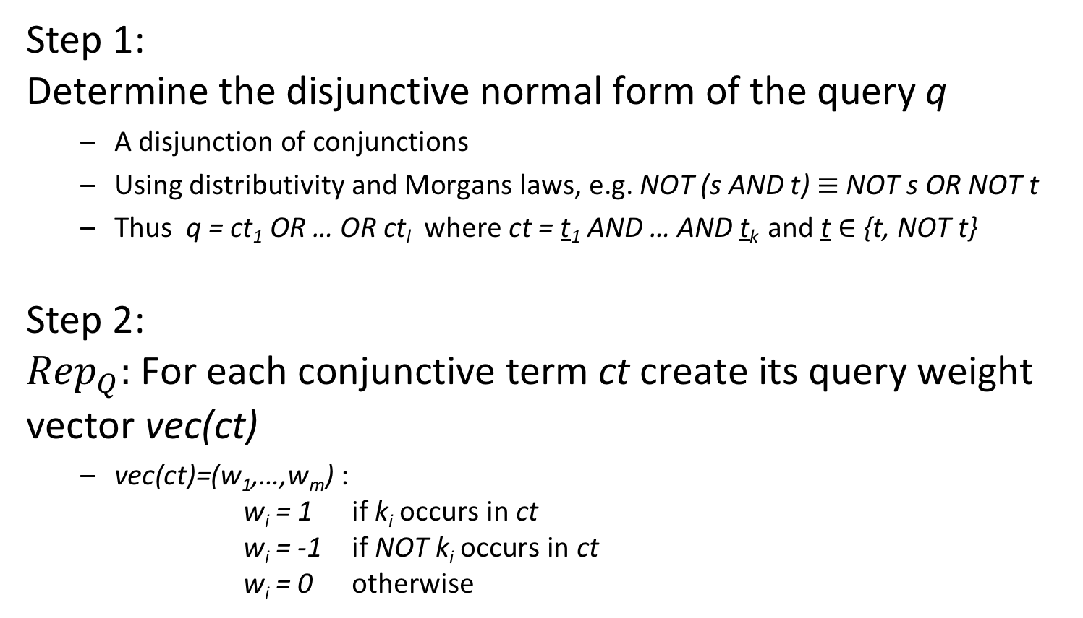
"Similarity" Computation in Boolean Retrieval
Step 1: Determine the disjunctive normal form of the query q
A disjunction of conjunctions
Using distributivity and Morgans laws, e.g. NOT (s AND t) $≡$ NOT s OR NOT t
Thus q = ct₁ OR … OR ct_{l} where ct = t₁ AND … AND t_{k} and t $∈$ {t, NOT t}
Step 2: ${Rep}_{Q}:$For each conjunctive term ct create its query weight vector vec(ct)
vec(ct)=(w₁,…,w_{m}) : w_{i} = 1 if k_{i} occurs in ct w_{i} = -1 if NOT k_{i} occurs in ct w_{i} = 0 otherwise
Notes:
Computing the similarity of a document and a query reduces in Boolean retrieval to the problem of checking whether the term occurrences in the document satisfy the logical condition specified by the query. In order to do so in a systematic manner, a Boolean query is first normalized into disjunctive normal form. Using this equivalent representation, checking whether a document matches the query reduces to the problem of checking whether the document vector, i.e., the column of the term-document matrix corresponding to the document, matches one of the conjunctive terms of the query.

Slide 29
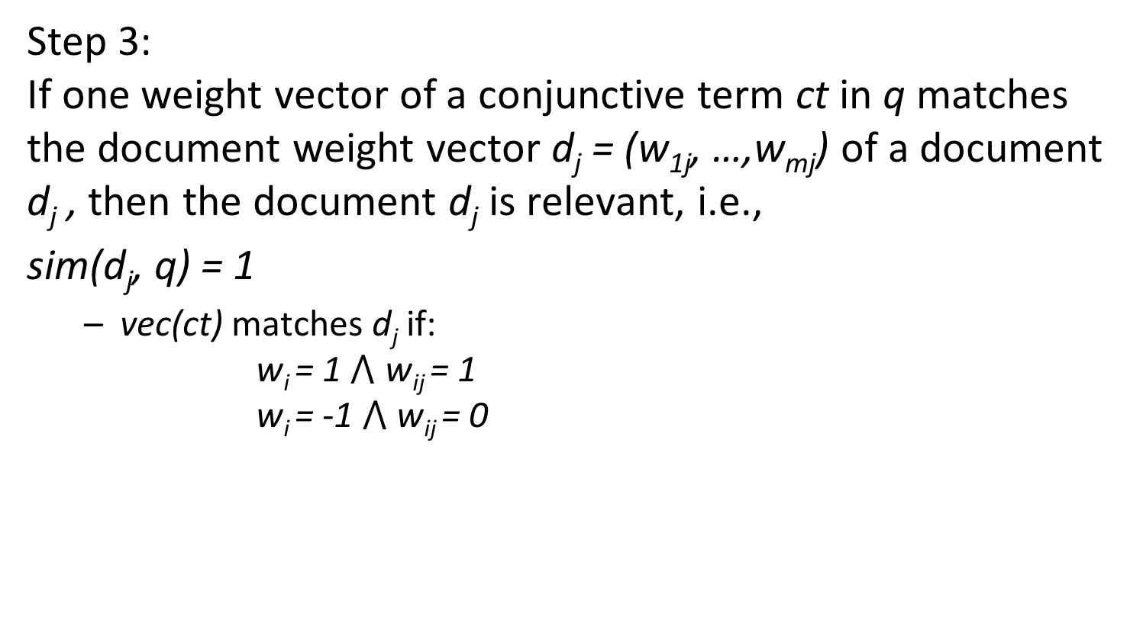
"Similarity" Computation in Boolean Retrieval
Step 3: If one weight vector of a conjunctive term ct in q matches the document weight vector d_{j} = (w_{1j}, …,w_{mj}) of a document d_{j} , then the document d_{j} is relevant, i.e.,
sim(d_{j}, q) = 1
vec(ct) matches d_{j} if: w_{i} = 1 $⋀$ w_{ij} = 1 w_{i} = -1 $⋀$ w_{ij} = 0
Notes:
A match is established if the document vector contains all the terms of the query vector in the correct way, i.e.,
if the term occurs in the positive form in the query the term must occur in the document
if the term occurs in the negated form in the query the term must not occur
If the term does not occur in the query, it may or may not occur in the document.

Slide 30
Example
Index terms {application, algorithm, theory}
Query "application" AND ("algorithm" OR NOT "theory")
Disjunctive normal form of query ("application" AND "algorithm" AND "theory") OR
("application" AND "algorithm" AND NOT "theory") OR
("application" AND NOT "algorithm" AND NOT "theory")
Query weight vectors q={(1,1,1), (1,1,-1), (1,-1,-1)}
Documents d₁={algorithm, theory, application} (1,1,1) d₂={algorithm, theory} (0,1,1) d₃={application, algorithm} (1,1,0)
Result sim(d₁, q) = sim(d₃, q) = 1, sim(d₂, q) = 0
Notes:
This example illustrates a complete Boolean retrieval process for our sample document collection.
The transformation from the original query to the disjunctive normal form proceeds in the following steps:
application AND (algorithm OR NOT theory) ->
(application AND algorithm) OR
(application AND NOT theory)->
(application AND algorithm AND (theory OR NOT theory) OR
(application AND (algorithm or NOT algorithm) AND NOT theory) ->
(application AND algorithm AND theory) OR
(application AND algorithm AND NOT theory) OR
(application AND algorithm AND NOT theory) OR
(application AND NOT algorithm AND NOT theory) ->
(application AND algorithm AND theory) OR
(application AND algorithm AND NOT theory) OR
(application AND NOT algorithm AND NOT theory)

Slide 31
1.2.3 Vector Space Retrieval
Limitations of Boolean Retrieval
No ranking: problems with handling large result sets
Queries are difficult to formulate
No tolerance for errors
Queries either return far too many results, or none
Key Idea of Vector Space Retrieval
Use “free text” queries
represent both the document and the query by a weight vector in the m-dimensional keyword space assigning non-binary weights
determine their distance in the m-dimensional keyword space
Notes:
The main limitation of the Boolean retrieval model is its incapability to rank the result and to match documents that do not contain all the keywords of the query. More complex requests become very difficult to formulate. Finally, for the user it is hard to predict whether a query would produce a reasonably sized set of results. Often either no results are returned, if the query is too restrictive or very large numbers of results are produced in the opposite case (this phenomenon is often called “feast or famine”).
The vector space retrieval model addresses these issues by supporting non-binary weights, i.e., real numbers in [0,1], both for documents and queries, and producing continuous similarity measures in [0,1]. The similarity measure is derived from the geometrical relationship of vectors in the m-dimensional space of document/query vectors. By using free text queries, i.e., users can use any text as query, the vector space model also simplifies the task of query formulation for users.

Slide 32
Similarity Computation in Vector Space Retrieval
k₁
d_{j}
Θ
q
k_{m}
Since w_{ij} > 0 and w_{iq} $≥$ 0, 0 $≤$ sim(q, d_{j}) $≤$ 1
Notes:
For information retrieval, the distance measure for vectors must satisfy the following properties:
If two vectors coincide completely their similarity should be maximal, i.e., equal to 1.
If two vectors have no keywords in common, i.e., if wherever the query vector has positive weights the document vector has weight 0, and vice versa – or in other words if the vectors are orthogonal – the similarity should be minimal, i.e., equal to 0.
in all other cases the similarity should be between 0 and 1.
The scalar product (which is equivalent to the cosine of the angle of two vectors) has exactly these properties and is therefore (normally) used as similarity measure for vector space retrieval.
A good question is why not use Euclidean distance, instead of cosine distance. The problem with using Euclidean distance is the following: different documents with the same or similar distribution of term weights, but of different vector length (for example, because the documents have different length) would give very different results, whereas their meaning would be the same or similar. For example, documents with vectors (1,1,0) and (2,2,0) would probably have the same meaning. But their Euclidean distances to a query vector would be very different (for illustration, consider the query vector (1,1,0)).

Slide 33
Vector Space Retrieval - Properties
Properties
Ranking of documents according to similarity value
Documents can be retrieved even if they don’t contain some query keyword
Today’s standard text retrieval technique
Web Search Engines
The vector model is the basis of most search engines, however they do not rely on it exclusively
It is simple and fast to compute
Notes:
The vector space retrieval model is the standard retrieval technique used both on the Web and for classical text retrieval.

Slide 34
Example
query vector: "application algorithms" (1,1)
document vector:
"algorithms" (0, 1) (B5, B7)
document vector: "application algorithms" (1,1) (B3)
Issue: how to determine
the weights for q and d_{j}?
document vector: "application" (1, 0) (B17)
Notes:
For vector space retrieval we need to determine of how weights are computed. If we apply the weighting scheme for the document and query vectors we have used for Boolean retrieval, we obtain the results vector space retrieval as shown in the figure. We observe that documents containing only one of the two keywords occurring in the query, can show up in the result, though with a lower similarity value.
Giving the same weight to all occurrences of terms does not account for the fact that different terms might have different importance for the meaning of a document. This was one of the reasons why in preprocessing the stopwords have been removed, as they do not contribute to the specific meaning of the document.

Slide 35
Term Frequency
Documents are similar if they contain the same keywords (frequently)
Therefore, use the frequency freq(i,j) of the keyword k_{i} in the document d_{j} to determine the weight of the document vectors
(Normalized) term frequency of term k_{i} in Document d_{j}
Notes:
An obvious difference that can be made among terms is with respect to their frequency of occurrence in a document. Thus, a weighting scheme for documents can be defined by considering the (relative) frequency of terms within a document. The term frequency is normalized with respect to the maximal frequency of all terms occurring within the document.

Slide 36
Example
Vocabulary T = {information, retrieval, agency}
Query q = (information, retrieval) = (1,1,0)
information … …retrieval …
…information…
…retrieval …
retrieval … …retrieval …
…retrieval …
…retrieval …
"Result"
D1 = (1, 1, 0)
sim(q,D1)=1
D2 = (0,1,0)
sim(q,D2)=0.7071…
agency … …information…
retrieval…
…agency …
retrieval … …agency …
…retrieval…
…agency…
D3 = (0.5,0.5, 1)
sim(q,D3)=0.5773…
D4 = (0, 1, 1)
sim(q,D4)=0.5
Notes:
This example illustrates the use of term frequency. Assume we form the query vector by simply setting the weight to 1 if the keyword appears in the query. Then we would obtain D1 and D2 as result. This result appears to be non-intuitive, since we would expect that D3 is much more similar to q than D2. What has gone wrong?
The problem is that the term "retrieval", since it occurs very frequently in D2, leads to a high similarity value for D2. On the other hand, the term retrieval has very little power to disambiguate meaning in this document collection, since every document contains this term. From an information-theoretic perspective one can state, that the term "retrieval" does not reduce the uncertainty about the result at all.

Slide 37
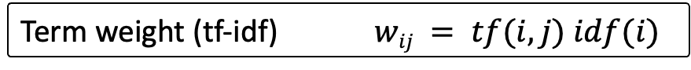
Inverse Document Frequency
We have not only to consider how frequent a term occurs within a document (measure for similarity), but also how frequent a term is in the document collection of size n (measure for distinctiveness)
Inverse document frequency can be interpreted as the amount of information associated with the term k_{i}
Inverse document frequency of term k_{i}
n_{i} number of documents in which term k_{i} occurs
Term weight (tf-idf) $wij = tf(i,j) idf(i)$
Notes:
Therefore, we should consider not only the frequency of a term within a document, when determining the importance of the term for characterizing the document, but also the discriminative power of the term with respect to the whole document collection. For that purpose, the inverse document frequency is computed and included into the term weight as factor.
With this weighting scheme we notice that eliminating stop words is in fact an optimization of computing similarity measures in vector space retrieval. Since stop words normally occur in every document of a collection, their term weights will normally be 0 and thus these terms will not receive any weight. Therefore, it makes sense to exclude them already on the preprocessing of documents.

Slide 38
Example
Vocabulary T = {information, retrieval, agency}
Query q = (information, retrieval) = (1,1,0)
idf(information)=idf(agency)=log(2)
idf(retrieval)=log(1)=0
information … …retrieval …
…information…
…retrieval …
retrieval … …retrieval …
…retrieval …
…retrieval …
D1 = (log(2), 0, 0)
sim(q,D1)=0.7071…
D2 = (0,0,0)
sim(q,D2)=0
"Result"
agency … …information…
retrieval…
…agency …
retrieval … …agency …
…retrieval…
…agency…
D3 = (0.5 log(2),0, log(2))
sim(q,D3)=0.316…
D4 = (0,0, log(2))
sim(q,D4)=0
Notes:
With the tf-idf weighting scheme we compute different weights.
We have now: n=4, n_{information}=2, n_{retrieval}=4, n_{agency}=2
The result corresponds much better to our expectation.

Slide 39
Query Weights
The same considerations as for document term weights apply also to query term weights
Example: Query q = (information, retrieval)
Query vector: (log(2), 0, 0)
Scores: sim(q, D1)= 1 sim(q, D2)=0 sim(q, D3)=0.44… sim(q, D4)=0
Query weight for query q
Notes:
Finally, we need to determine the weights for the query vector. One approach is to apply the same method as for determining the weights of the document vector, considering the query as a document. In practice, there exist different variations of this approach.

Slide 40
Example
Query q = "application theory"
Boolean retrieval result
application AND theory: B3, B17
application OR theory: B3, B11, B12, B17
Vector retrieval result
Query vector (0, 0.77…, 0, 0, 0, 0, 0, 0, 0, 0, 0, 0, 0, 0, 0, 0.63)
Ranked Result: B17 1.0 B3 0.69 B12 0.28 B11 0.28
Notes:
This examples provides an illustration of the differences of Boolean and vector space retrieval.

Slide 41
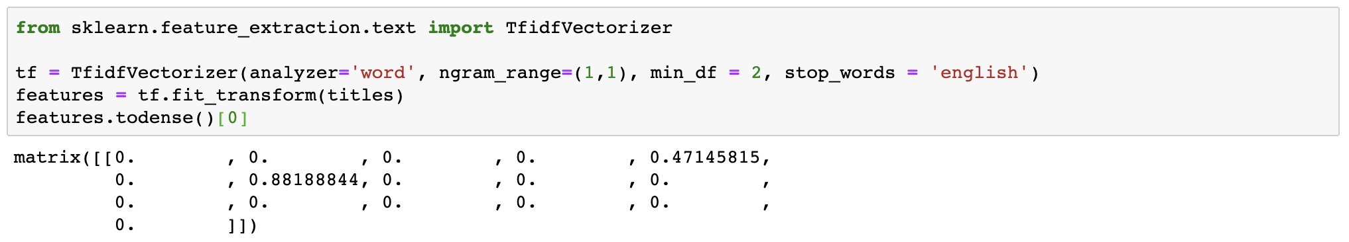
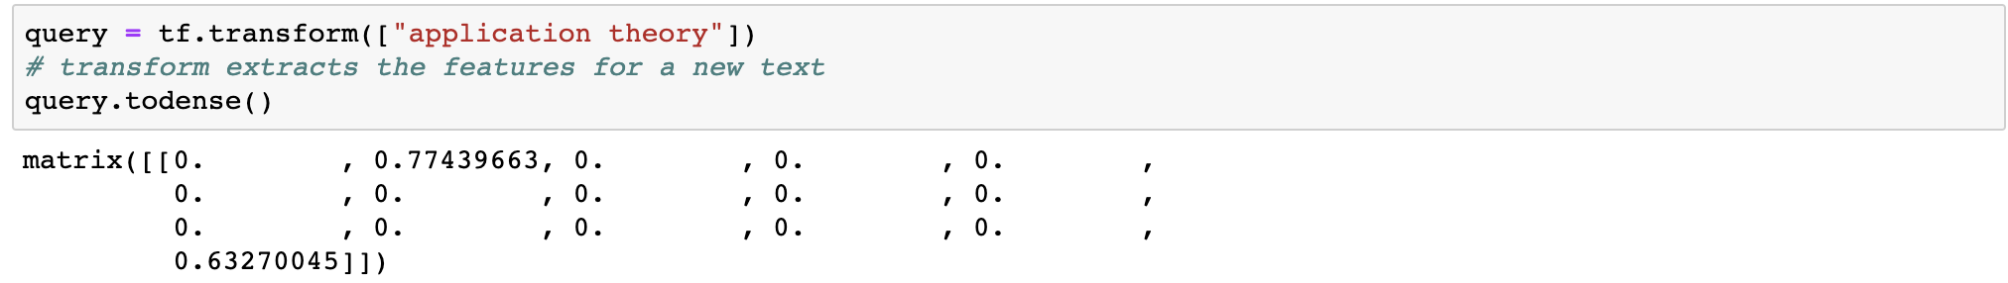
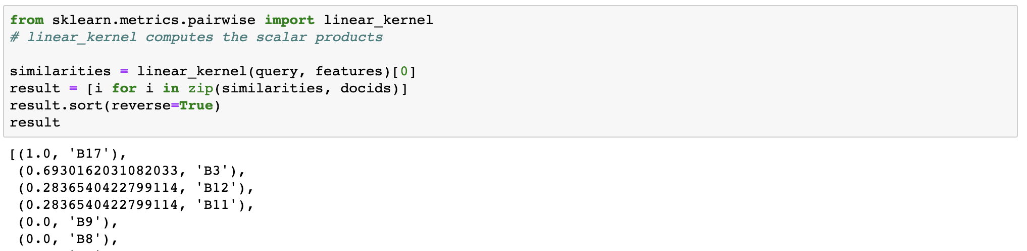
Implementation in Python
Notes:
This is an implementation of basic vector space retrieval in Python.

Slide 42
Let the Boolean query be represented by {(1, 0, -1), (0, -1, 1)} and the document by (1, 0, 1). The document …
matches the query because it matches the first query vector
matches the query because it matches the second query vector
does not match the query because it does not match the first query vector
does not match the query because it does not match the second query vector

Slide 43
The term frequency of a term is normalized …
by the maximal frequency of all terms in the document
by the maximal frequency of the term in the document collection
by the maximal frequency of any term in the vocabulary
by the maximal term frequency of any document in the collection

Slide 44
The inverse document frequency of a term can increase …
by adding the term to a document that contains the term
by removing a document from the document collection that does not contain the term
by adding a document to the document collection that contains the term
by adding a document to the document collection that does not contain the term

Slide 45
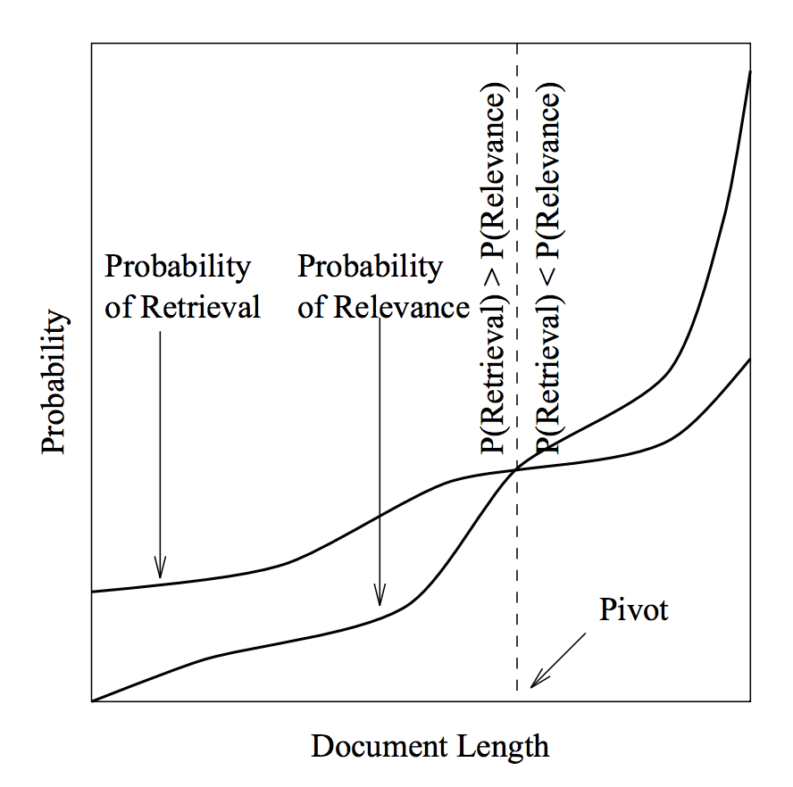
The Role of Document Length
When computing cosine similarity, document vectors are normalized
Result: for Query “information”: doc2 will be favored because it is shorter
information agency retrieval system
doc1
(0.25,0.25,0.25,0.25)
information
agency
doc2
Singhal 1996
(0.5,0.5,0,0)
Notes:
For a long time, it was suspected that the standard vector space retrieval method favors short documents over long documents as a result of the normalization of document vectors. When normalizing document vectors, a term that occurs in the query would receive a lower weight in a longer document, as it shares the total weight of 1 with a larger number of terms, and thus the longer document is less likely to receive a high rank. Still, the question is whether this hurts retrieval performance.
In a seminal paper Singhal and co-authors provided empirical evidence confirming that retrieval performance is suffering from this problem. They compared for a TREC dataset the probability P(relevance) of a document of a given length of being relevant (by relying on the manual evaluation) with the probability P(retrieval) that a document of that length would be retrieved using standard vector space retrieval. The graph clearly shows that shorter documents have better chances to show up in a result, than longer ones, even when they are less relevant. The pivot point is the document length where the both probabilities match.

Slide 46
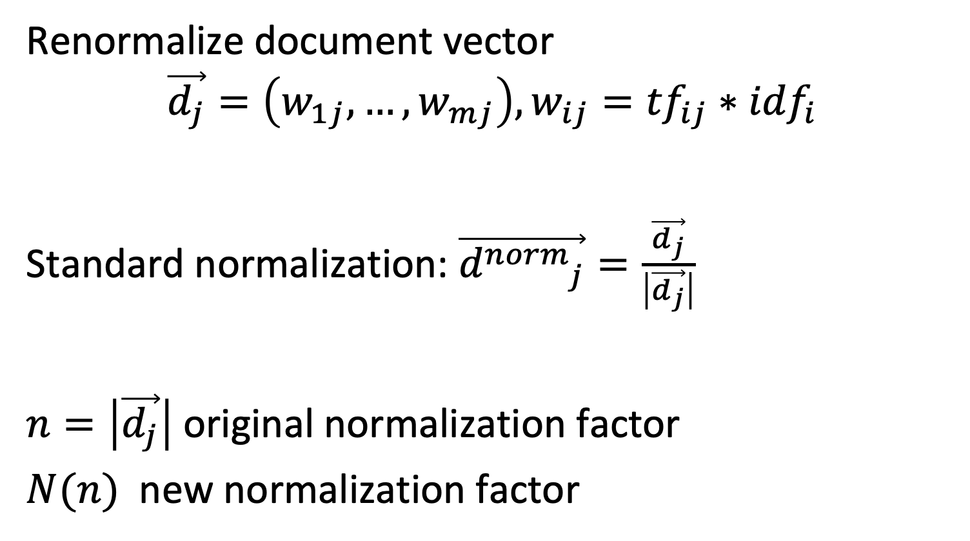
Normalization of Document Vector
Renormalize document vector
$$\vec{d_{j}}=\left(w_{1j},…,w_{mj}\right), w_{ij}={tf}_{ij}∗{idf}_{i}$$
Standard normalization: $\vec{{d^{norm}}_{j}}=\frac{\vec{d_{j}}}{\left|\vec{d_{j}}\right|}$
$n=\left|\vec{d_{j}}\right|$ original normalization factor
$N(n)$ new normalization factor
Notes:
The standard approach for normalizing document vectors is to normalize it to length 1. This approach leads to the afore mentioned problem of favoring shorter documents.
One possibility to address the problem is to modify the normalization factor. If we consider the original normalization factor $n=\left|\vec{d_{j}}\right|$ the approach would be to replace it with a modified normalization factor $N(n)$that is a function of the original normalization factor. This new normalization should be designed to favor longer documents. That is achieved by giving more weight to those documents, which again can be achieved by choosing a smaller normalization factor.

Slide 47
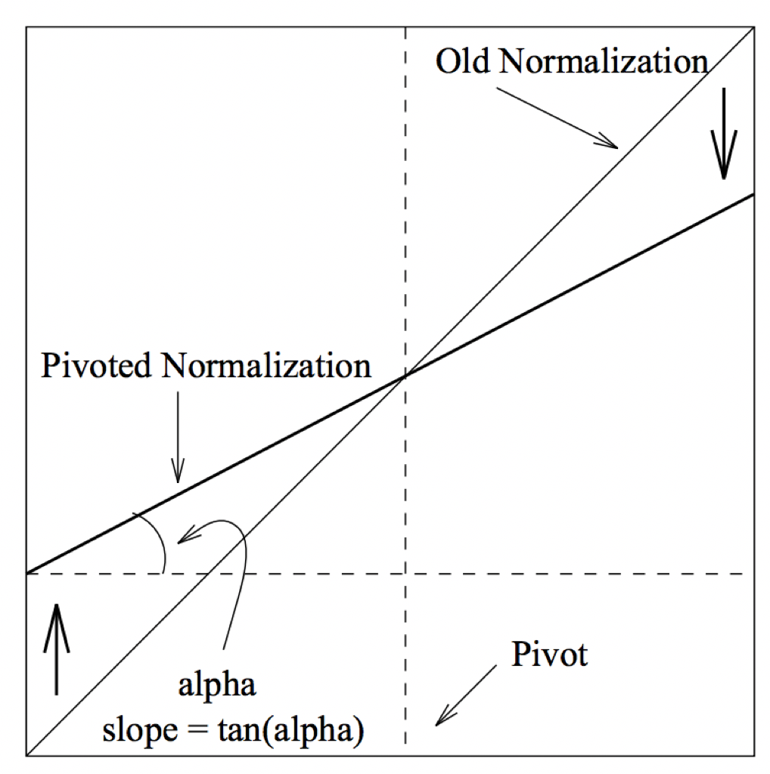
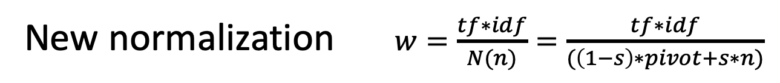
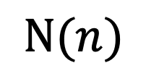
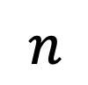
Compensating Bias towards Short Documents
$N(n)$
Slope s
s * pivot
(1 – s) * pivot
$n$
New normalization $w=\frac{tf∗idf}{N(n)}=\frac{tf∗idf}{(\left(1−s\right)∗pivot+s∗n)}$
Notes:
To correct for the influence of document length, different normalization schemes have been proposed. We introduce the one introduced in the work from Singhal.
A first observation is that the original and new normalization should be the same for the document length at which the probability of relevance and retrieval are the same, the pivot point. The function $N(n)$is designed as a linear function that has larger values below the pivot and smaller values above. Therefore, a slope s for the function needs to be chosen. The pivot point and slope parameter needs to be determined empirically, by comparing retrieval performance of parameters for a given document collection.

Slide 48
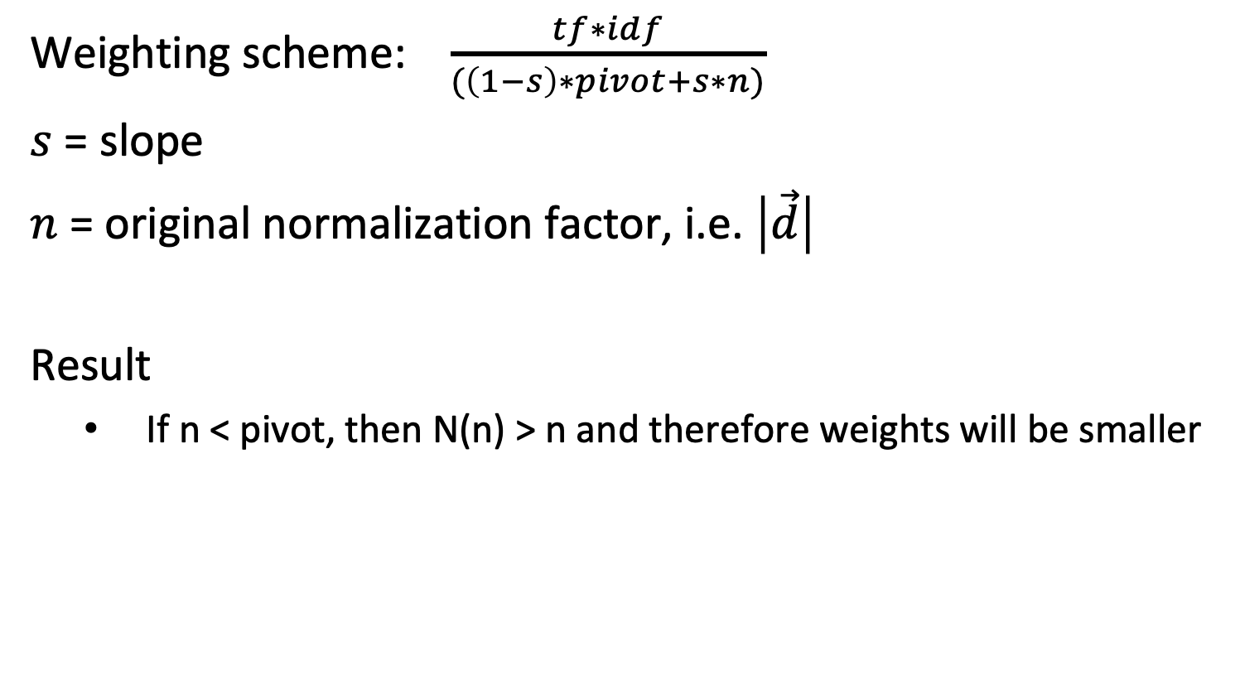
Length Normalization
Weighting scheme: $\frac{tf∗idf}{(\left(1−s\right)∗pivot+s∗n)}$
$s$ = slope
$n$ = original normalization factor, i.e. $\left|\vec{d}\right|$
Result
If n < pivot, then N(n) > n and therefore weights will be smaller
Notes:
With this normalization factor N(n) the weights of shorter documents, more precisely for those where the normalization factor n is smaller, will be reduced.

Slide 49
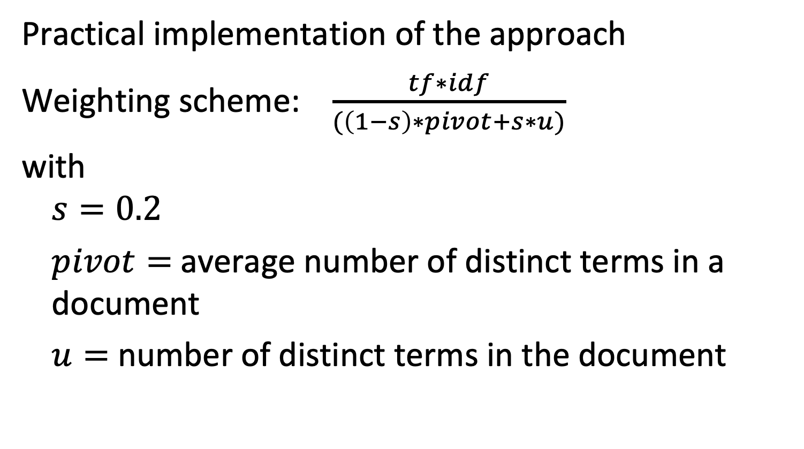
Pivoted Unique Query Normalization
Practical implementation of the approach
Weighting scheme: $\frac{tf∗idf}{(\left(1−s\right)∗pivot+s∗u)}$
with
$$s=0.2$$
$pivot=$average number of distinct terms in a document
$u=$ number of distinct terms in the document
Notes:
Determining the pivot and slope parameters empirically might be costly or not possibly in practice. Therefore, heuristics for determining those parameters based on statistical properties of the document collections have been proposed.
One of them is pivoted unique query normalization. It uses the average number of distinct terms in a document as pivot point. The slope parameter is a constant value, where 0.2 has been identified as suitable. Document length is measured in terms of number of distinct terms in a given document.

Slide 50
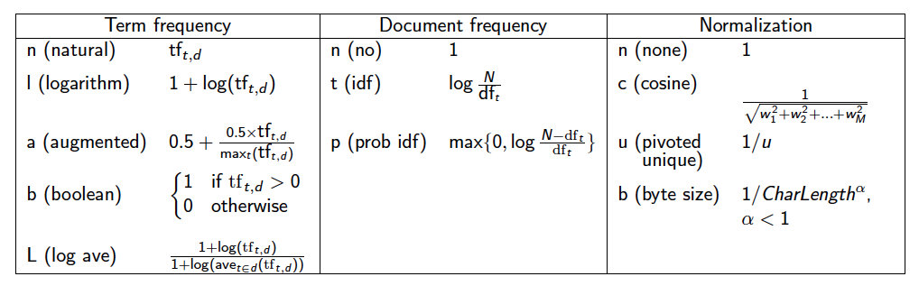
Variants of Vector Space Retrieval Model
The vector model with tf-idf weights is a good ranking strategy for general collections
many alternative weighting schemes exist, but are not fundamentally different
Notes:
Different variants of tf-idf weighting schemes have been developed and used over time. They can be combined with each other, also independently for the weighting of document and query terms. One important variant is the logarithmic weighting of term frequencies, which moderates the influence of very frequently occurring terms in documents. In the normalization approaches, the parameter u in pivoted unique, corresponds to the number of unique terms in a document.

Slide 51
Discussion of Vector Space Retrieval Model
Advantages
term-weighting improves quality of the answer set
partial matching allows retrieval of docs that approximate the query conditions
cosine ranking formula sorts documents according to degree of similarity to the query
Disadvantages
assumes independence of index terms; not clear that this is a disadvantage
No theoretical justification why the model works
Notes:
We summarize here the main advantages of the vector space retrieval model. It has proven to be a very successful model for general text collections, i.e., if there exists no additional (context) information on the documents that could be exploited, e.g., from a specific application domain. Providing a ranked result improves the usability of the approach, as users can more easily distinguish more relevant documents from less relevant documents. The model inherently assumes that there exist no mutual dependencies in the occurrences of the terms, i.e., that certain terms appear together more frequently than others. Studies have shown that taking such co-occurrence probabilities additionally into account, can actually HURT the performance of the retrieval system. The reason is that co-occurrence probabilities are often related to specific application domains and thus do not easily transfer from context to another.
One of the principal criticisms of the vector space model is the lack of theoretical explanation why it works. At the end, it is a heuristics. This drawback has been addressed with other models, in particular probabilistic retrieval models.

Slide 52
1.2.4 Evaluating Information Retrieval
Quality of a retrieval model depends on how well it matches user needs!
Comparison to database querying
correct evaluation can be formally verified
Notes:
The performance of an information retrieval system can be determined by evaluating the satisfaction of users, which is a context-dependent task. This is fundamentally different to database querying, where there exist formal criteria for validating correctness of query answering.

Slide 53
Evaluating Information Retrieval
Test collections with test queries, where the relevant documents are identified manually, are used to determine the quality of an IR system (e.g. TREC)
Document collection
True negatives
False negatives
Relevant documents R
True positives
Answer set A
False positives
Notes:
Since there exists no formal criterion whether an information retrieval query is correctly answered, other means for evaluating the quality of an information retrieval system are required. The basic approach is to compare the performance of a specific system to human performance for the same retrieval task. For that purpose benchmark collections of documents, such as TREC (http://trec.nist.gov/), are created and for selected queries human experts select the relevant documents. Note that this approach assumes that humans have an agreed-upon, objective notion of relevance, an assumption that is in general not satisfied.

Slide 54
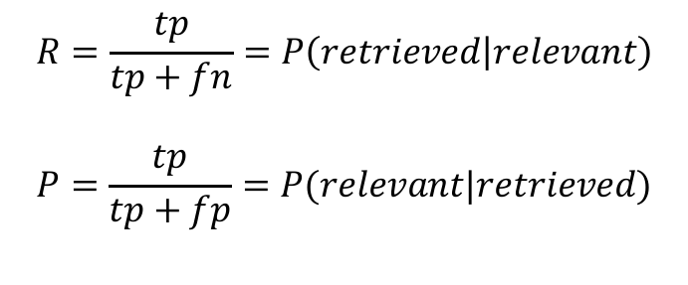
1.2.4.1 Recall and Precision
Recall is the fraction of relevant documents retrieved from the set of total relevant documents collection-wide
Precision is the fraction of relevant documents retrieved from the total number retrieved (answer set)
 | Relevant | Non-relevant
Retrieved | True positives (tp) | False positives (fp)
Not Retrieved | False negatives (fn) | True negatives (tn)
$$R=\frac{tp}{tp+fn}=P\left(retrieved | relevant\right)$$
$$P=\frac{tp}{tp+fp}=P(relevant|retrieved)$$
Notes:
The results of IR systems can be compared to the expected result in two ways:
Recall measures how large a fraction of the expected results is actually found.
Precision measures how many of the results returned are actually relevant.
Important note: This measure evaluates an unranked result set. All elements of the result are considered as equally important.

Slide 55
Recall and Precision – A Tradeoff
Suppose you search for “Theory of Relativity”.
Optimizing recall: retrieve all pages mentioning “theory” and “relativ*”
We will have probably most documents talking about the topic
We might have results such as, “In theory, I feel relatively good”, “Relative to the theory of evolution …” etc.
Optimizing precision: retrieve all pages mentioning “relativity theory” and “expanding universe”
Most likely all results are relevant
But we might miss “the theory of relativity by Einstein”
Thus, high recall hurts precision and vice versa
Notes:
This example illustrates a fundamental trade-off between recall and precision. Achieving high recall in general lowers precision and vice versa. In the extreme case, it is always possible to achieve 100% recall at the expense of having the lowest possible precision.

Slide 56
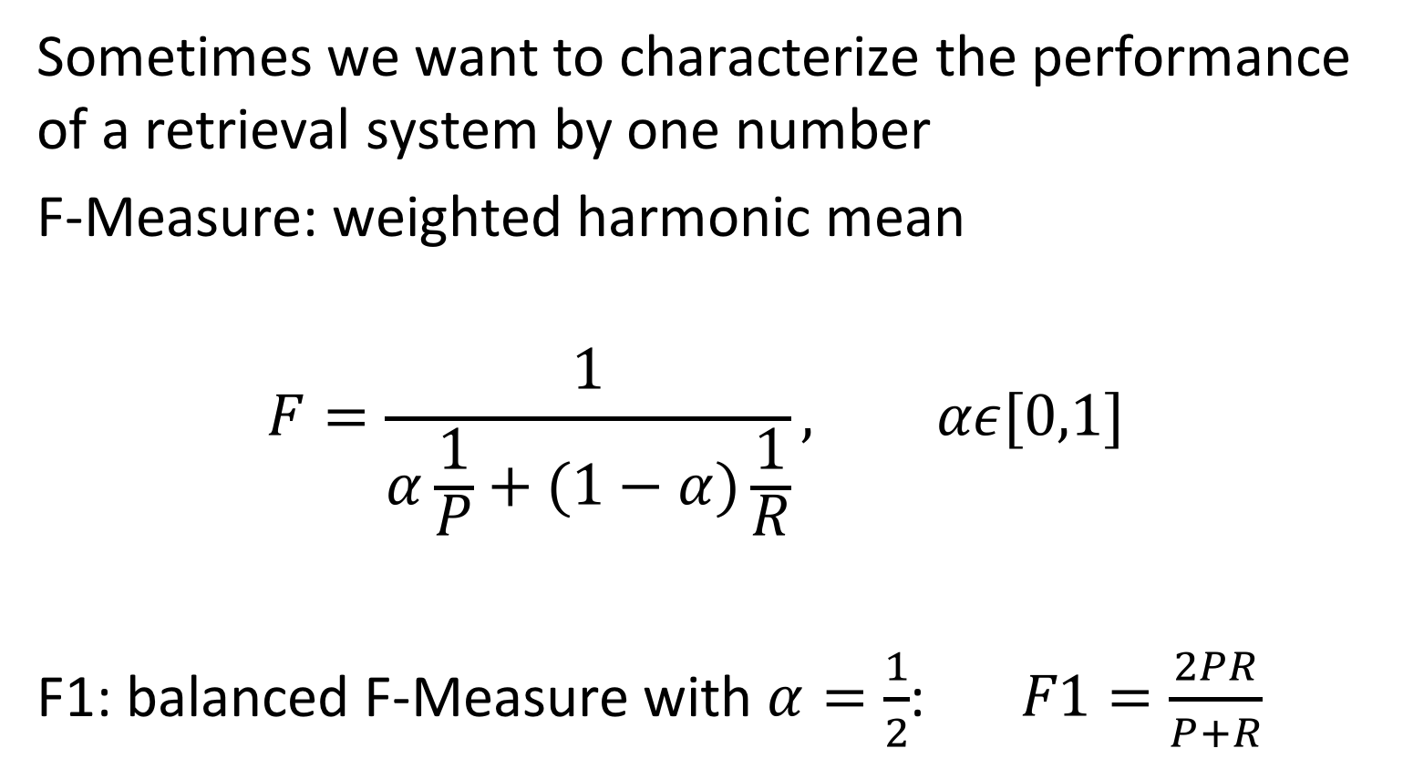
Combined Measures
Sometimes we want to characterize the performance of a retrieval system by one number
F-Measure: weighted harmonic mean
$$F=\frac{1}{α\frac{1}{P}+(1−α)\frac{1}{R}}, αε[0,1]$$
F1: balanced F-Measure with $α=\frac{1}{2}$: $F1=\frac{2PR}{P+R}$
Notes:
Sometimes one prefers to characterize the performance of an information retrieval system by a single measure, by combining recall and precision in a single quantity. Arithmetic mean could be a possible choice, but is not very suitable. When choosing 100% recall we would always have at least 50% as the arithmetic mean between recall and precision.
Therefore, the harmonic mean is used. It can be tuned by a parameter alpha. Larger values of alpha emphasize the importance of precision and smaller ones the importance of recall.

Slide 57
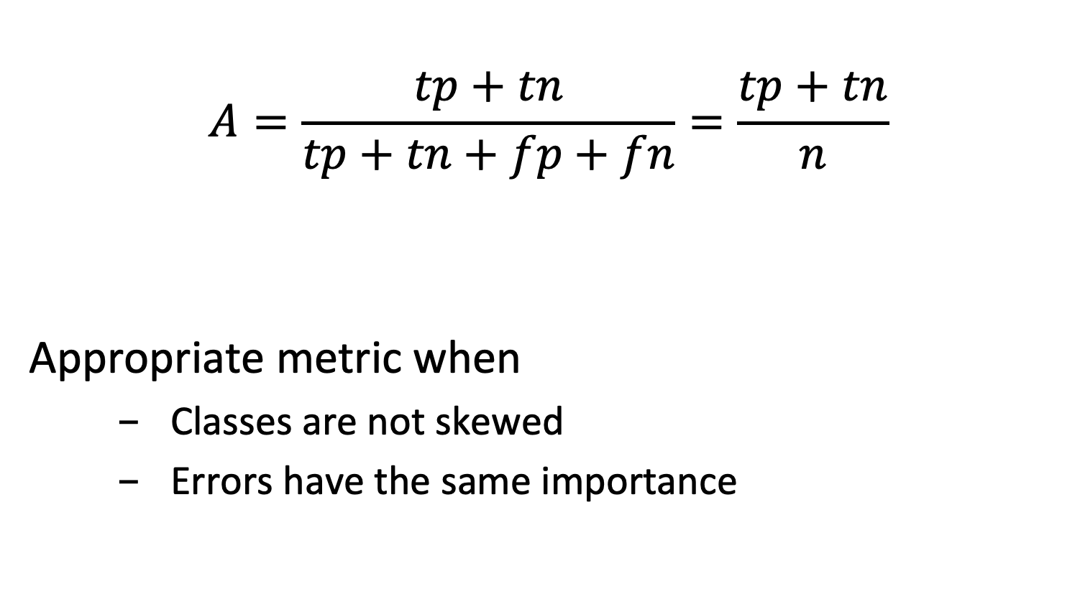
Accuracy
$$A=\frac{tp+tn}{tp+tn+fp+fn}=\frac{tp+tn}{n}$$
Appropriate metric when
Classes are not skewed
Errors have the same importance
Notes:
Accuracy is another possible measure for performance. Accuracy is a standard way to measure performance of binary classifiers, and retrieval can be understood as the task of classifying documents into relevant and non-relevant ones. However, accuracy only works well if the positive and negative cases are approximately equally distributed, and the importance of having false positives and false negatives is similar.
We will illustrate the potential issues in the following.

Slide 58
Accuracy - Pitfall
Classifier 1 |  | Class
 |  | Fraud | ¬Fraud
Classified | Fraud | 5 | 10
 | ¬Fraud | 5 | 80
A = 85/100 = 0.85
A = 90/100 = 0.90
Always ¬Fraud |  | Class
 |  | Fraud | ¬Fraud
Classified | Fraud | 0 | 0
 | ¬Fraud | 10 | 90
Notes:
Assume we want to retrieve documents that indicate a fraud and that in the majority of cases a document does not refer to fraud.
Accuracy as a performance metrics is inappropriate in case of such skewed class distributions. The typical problem is that a trivial classifier that classifies everything as belonging to the majority class, can achieve easily higher accuracies than a classifier that attempts to also correctly classify samples in the minority class.

Slide 59
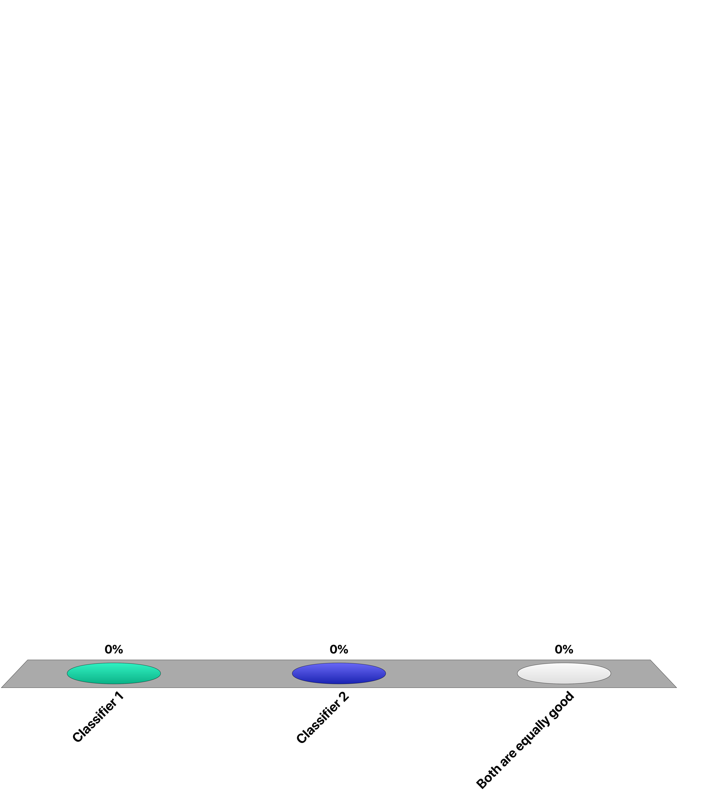
Which is the “best” classifier?
Classifier 1 |  | Class
 |  | A | B
Classified | A | 45 | 20
 | B | 5 | 30
Classifier 2 |  | Class
 |  | A | B
Classified | A | 40 | 10
 | B | 10 | 40
Classifier 1
Classifier 2
Both are equally good

Slide 60
Which is the “best” classifier?
Classifier 1 |  | Class
 |  | Cancer | ¬Cancer
Classified | Cancer | 45 | 20
 | ¬Cancer | 5 | 30
Classifier 2 |  | Class
 |  | Cancer | ¬Cancer
Classified | Cancer | 40 | 10
 | ¬Cancer | 10 | 40
Classifier 1
Classifier 2
Both are equally good

Slide 61
Precision and Recall: Example
P₁=45/65=0.69 P₂=40/50=0.8
R₁=45/50=0.9 R₂=40/50=0.8
Classifier 1 |  | Class
 |  | Cancer | ¬Cancer
Classified | Cancer | 45 | 20
 | ¬Cancer | 5 | 30
Classifier 2 |  | Class
 |  | Cancer | ¬Cancer
Classified | Cancer | 40 | 10
 | ¬Cancer | 10 | 40
Everybody has cancer |  | Class
 |  | Cancer | ¬Cancer
Classified | Cancer | 50 | 50
 | ¬Cancer | 0 | 0
P = 50/100 = 0.5
R = 50/50 = 1
Notes:
With precision and recall we can better control the kind of results we prefer to obtain. For example, for the case of cancer detection we would prefer to have higher recall to miss fewer cancer cases, even if we diagnose erroneously cancer in a few cases. Therefore, classifier 1 would be preferred over classifier 2 (which did better in terms of accuracy). Of course we can increase the recall arbitrarily, e.g., with a trivial classifier diagnosing cancer for everyone. But this also causes that 50% of the patients with no cancer go home worried about their health status.
That is why still precision needs to be considered in the evaluation as second criterion.
Note that by using precision and recall we make the evaluation “asymmetric”. We focus in the evaluation on the positive class, since higher recall means more positive cases identified.

Slide 62
F-Score: Example (alpha = 1/2)
F₁=2*(0.69*0.9)/(0.69+0.9) F₂=2*(0.8*0.8)/(0.8+0.8)
= 0.78 =0.8
Classifier 1 |  | Class
 |  | Cancer | ¬Cancer
Classified | Cancer | 45 | 20
 | ¬Cancer | 5 | 30
Classifier 2 |  | Class
 |  | Cancer | ¬Cancer
Classified | Cancer | 40 | 10
 | ¬Cancer | 10 | 40
Everybody has cancer |  | Class
 |  | Cancer | ¬Cancer
Classified | Cancer | 50 | 50
 | ¬Cancer | 0 | 0
F=2*(0.5*1)/(0.5+1)=0.66
Notes:
With the F1 score still classifier 2 is evaluated as slightly better than classifier 1.

Slide 63
F-alpha-Score: Example (alpha = 1/5)
F₁=5*(0.69*0.9)/(4*0.69+0.9) F₂=5*(0.8*0.8)/(4*0.8+0.8)
= 0.84 =0.8
Classifier 1 |  | Class
 |  | Cancer | ¬Cancer
Classified | Cancer | 45 | 20
 | ¬Cancer | 5 | 30
Classifier 2 |  | Class
 |  | Cancer | ¬Cancer
Classified | Cancer | 40 | 10
 | ¬Cancer | 10 | 40
Everybody has cancer |  | Class
 |  | Cancer | ¬Cancer
Classified | Cancer | 50 | 50
 | ¬Cancer | 0 | 0
F=5*(0.5*1)/(4*0.5+1)=0.83
Notes:
With the F-alfa score, alfa=1/5, we can give more importance to recall and as a result indeed classifier 1 turns out to be have a better performance under this measure.
Sometimes also an F-beta score is computed substituting alfa = (1/1+beta^2), resulting in $F_{β}=(1+β^{2})\frac{PR}{β^{2}P+R}$
In this example we would have beta = 2.

Slide 64
If the top 100 documents contain 50 relevant documents …
the precision of the system at 50 is 0.25
the precision of the system at 100 is 0.5
the recall of the system is 0.5
All of the above

Slide 65
If retrieval system A has a higher precision at k than system B …
the top k documents of A will have higher similarity values than the top k documents of B
the top k documents of A will contain more relevant documents than the top k documents of B
A will recall more documents above a given similarity threshold than B
the top k relevant documents in A will have higher similarity values than in B

Slide 66
1.2.4.2 Precision/Recall Tradeoff in Ranked Retrieval
An IR system ranks documents by a similarity coefficient, allowing the user to trade off between precision and recall by choosing the cutoff level
Precision and recall depend on the number of results retrieved: P@k = precision for the top-k documents R@k = recall for the top-k documents
hypothetical ideal IR system
realistic IR systems
Notes:
One of the two measures of recall and precision can always be optimized. Recall can be optimized by simply returning the whole document collection, whereas precision can be optimized by returning only very few results. Important is the trade-off: the higher the precision for a specific recall, the better the information retrieval system. A hypothetical, optimal information retrieval system would return results with 100% percent precision always. If a system ranks the results according to relevance the user can control the relation between recall and precision by selecting a threshold of how many results the user inspects.

Slide 67
Evaluating Ranked Retrieval
Recall-Precision Plot
R N R N R R N N R R R N R N R R (10 relevant documents)
Notes:
The recall-precision graph lists on the x-axis the documents according to their ranking and on the y-axis the precision achieved when returning the set of documents up to the rank.
If we draw the Recall-Precision graph for a ranked retrieval result, we will find the following picture. The precision will always drop when non-relevant documents are returned and increase when relevant documents are returned. The green dots correspond to relevant documents and the red dots to non-relevant ones.

Slide 68
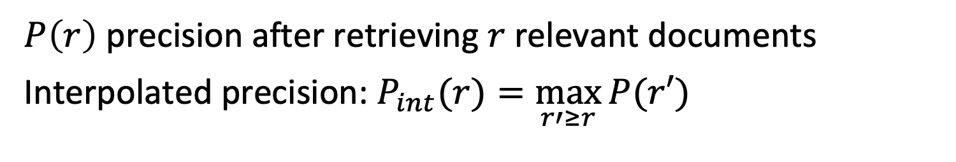
Interpolated Precision
$P\left(r\right)$ precision after retrieving $r$ relevant documents
Interpolated precision: $P_{int}(r)=\max_{r′≥r}{P(r′)}$
Notes:
In order to convert the recall-precision plot into a monotonically decreasing function, interpolated precision is introduced, which returns always the maximum precision over all recalls r’ that are greater than r.

Slide 69
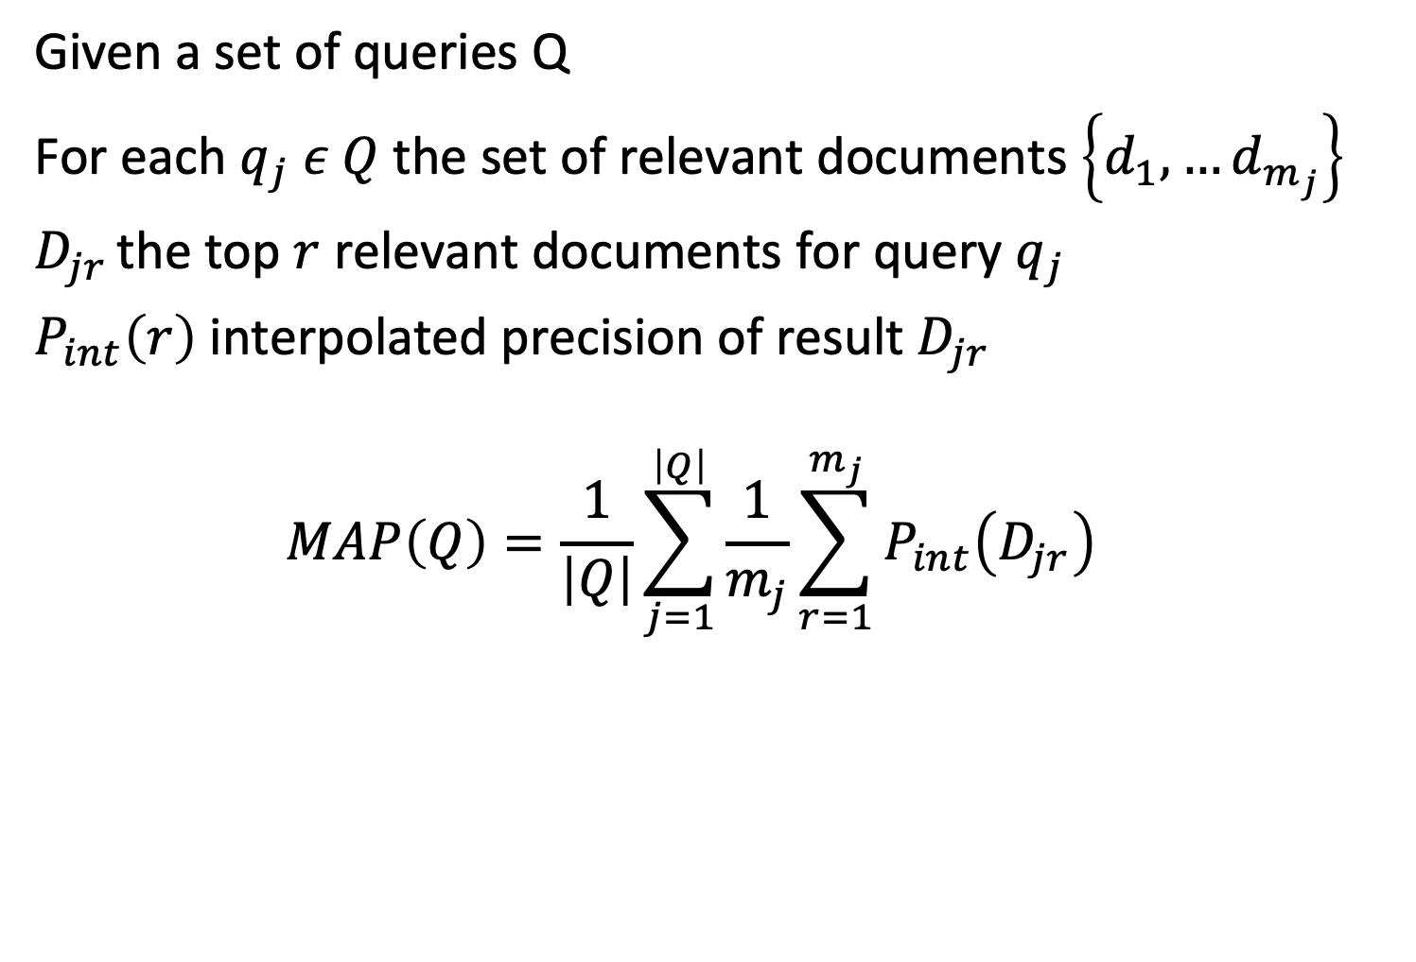
Mean Average Precision (MAP)
Given a set of queries Q
For each $q_{j} ε Q$the set of relevant documents $\left\{d_{1}, …d_{m_{j}}\right\}$
$D_{jr }$the top $r$ relevant documents for query $q_{j}$
$P_{int}\left(r\right)$ interpolated precision of result $D_{jr }$
$$MAP\left(Q\right)=\frac{1}{\left|Q\right|}\sum_{j=1}^{\left|Q\right|}{\frac{1}{m_{j}}}\sum_{r=1}^{m_{j}}{P_{int}\left(D_{jr}\right)}$$
Notes:
Mean Average Precision has been shown to be a robust measure for evaluating the quality of a ranked retrieval system for a query collection Q. When a relevant document is not retrieved at all, the precision value in the MAP is 0.

Slide 70
Example
Assume 4 results are returned for a query q:
R N R N
P@1 = 1, P@2 = 0.5, P@3 = 2/3, P@4 = 0.5
P_{int} (1)= 1, P_{int} (2) = 2/3
Then MAP({q}) = 1/2 (1 + 2/3) = 5/6
(note : only precision values when retrieving a relevant document are considered)
Notes:
A simple example where the query set Q to be evaluated consists of a single query q. For multiple queries the results would be averaged.

Slide 71
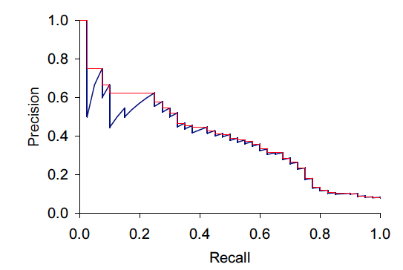
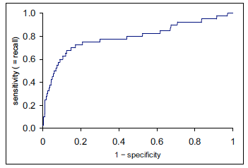
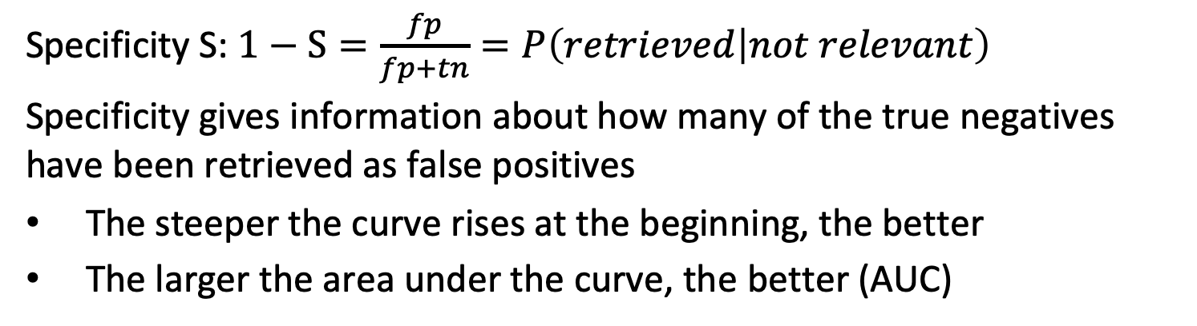
ROC Curve
True positives
False positives
Specificity S: $1−S=\frac{fp}{fp+tn}=P\left(retrieved | not relevant\right)$
Specificity gives information about how many of the true negatives have been retrieved as false positives
The steeper the curve rises at the beginning, the better
The larger the area under the curve, the better (AUC)
Notes:
Another frequently used approach to globally evaluate ranked retrieval is the ROC curve. The ROC curve is frequently loosely called a recall-precision curve, which is not accurate (as the figure shows).
The ROC curve relates specificity (on the x-axis) to recall (on the y-axis). Specificity measures the fraction of true negatives that are detected in proportion to all negatives. Thus 1 – specificity is the rate of false positives that have been retrieved, the so-called false positive rate (FPR). In other words, it is the fraction of non-relevant documents among all non-relevant documents that occur in the result. The desired behavior of an IR system is that the curve raises quickly at the beginning, which means that many relevant results are retrieved without having a high fraction of non-relevant documents. This is also equivalent to saying that the area under the curve should be large. Therefore, the area under the ROC curve is sometimes considered similarly as an evaluation of the overall retrieval quality of a retrieval system, analogous to the MAP measure.
Example:
When the recall is at 0.5 then 1-S is at 0.1. This implies that S is 0.9. Then we can conclude that fp = 1/9 tn, or in other words when retrieving half of the relevant documents, then we have also retrieved about 10% of the non-relevant documents.

Slide 72
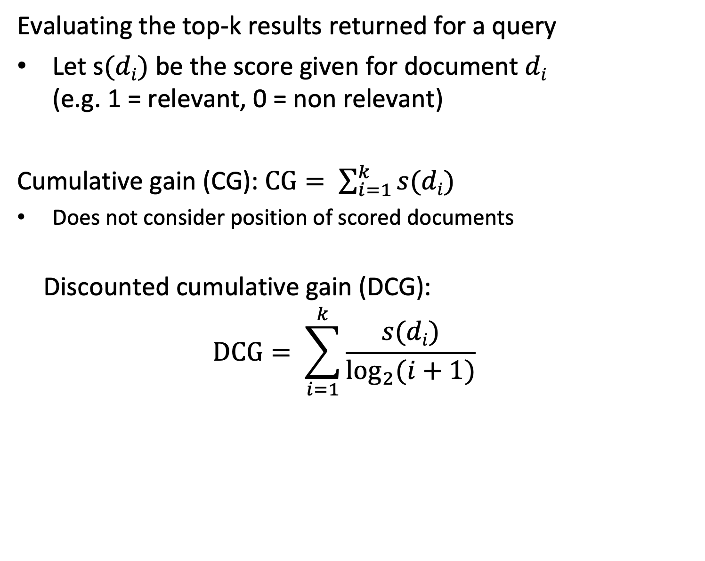
Considering Similarity Scores and Position
Evaluating the top-k results returned for a query
Let s$(di)$ be the score given for document $di$ (e.g. 1 = relevant, 0 = non relevant)
Cumulative gain (CG): $CG= \sum_{i=1}^{k}{s(di)}$
Does not consider position of scored documents
Discounted cumulative gain (DCG): $$DCG= \sum_{i=1}^{k}{\frac{s(di)}{\log_{2}{(i+1)}}}$$
Notes:
NDCG builds on the concepts of cumulative gain (CG) and discounted cumulative gain (DCG).
With CG the scores of the top-k ranked items are added up. The higher this value, the higher the quality of the predicted scores.
CG does not consider the position of the scores, whereas in practice the earlier positions are more important. Therefore, with DCG a weighting function for the positions is included, which gives higher weight to the earlier positions. The method has its background in finance, where for investments gains in earlier years are higher weighted than gains further into the future.

Slide 73
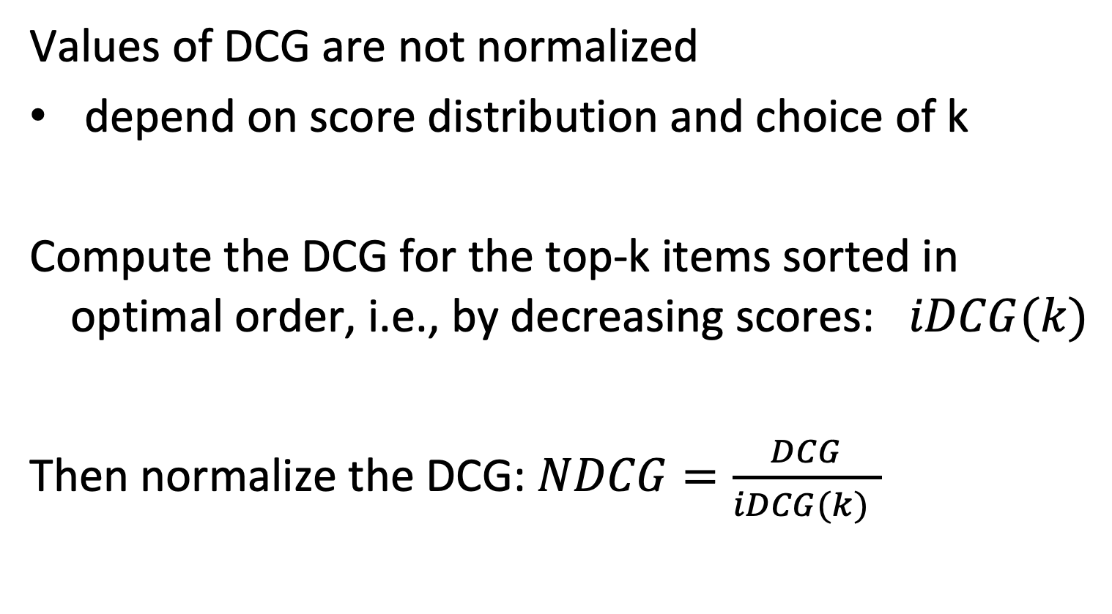
Normalized DCG (NDCG)
Values of DCG are not normalized
depend on score distribution and choice of k
Compute the DCG for the top-k items sorted in optimal order, i.e., by decreasing scores: $iDCG(k)$
Then normalize the DCG: $NDCG=\frac{DCG}{iDCG(k) }$
Notes:
Finally, the metrics provided by DCG is not normalized and can thus not be compared for different rating schemes and choices of k. To calibrate the values, the DCG for the optimally sorted items is considered as baseline. By normalizing the DCS using this baseline, one obtains the NDCG, as a standardized measure for ranking quality in the interval [0,1].

Slide 74
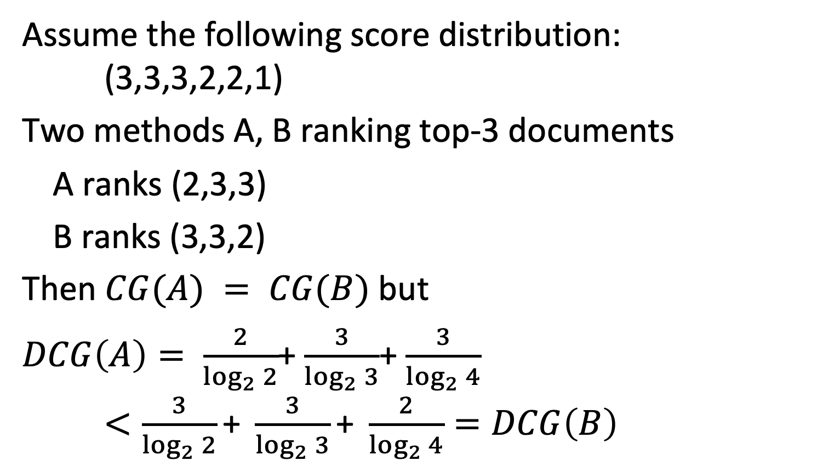
Example
Assume the following score distribution: (3,3,3,2,2,1)
Two methods A, B ranking top-3 documents
A ranks (2,3,3)
B ranks (3,3,2)
Then $CG(A) = CG(B)$ but
$DCG\left(A\right)= \frac{2}{\log_{2}{2}}$+ $\frac{3}{\log_{2}{3}}$+ $\frac{3}{\log_{2}{4}}$ $<\frac{3}{\log_{2}{2}}\text{+} \frac{3}{\log_{2}{3}}\text{+} \frac{2}{\log_{2}{4}}=DCG\left(B\right)$
Notes:
The example illustrates the different steps in the calculation of NDCG.

Slide 75
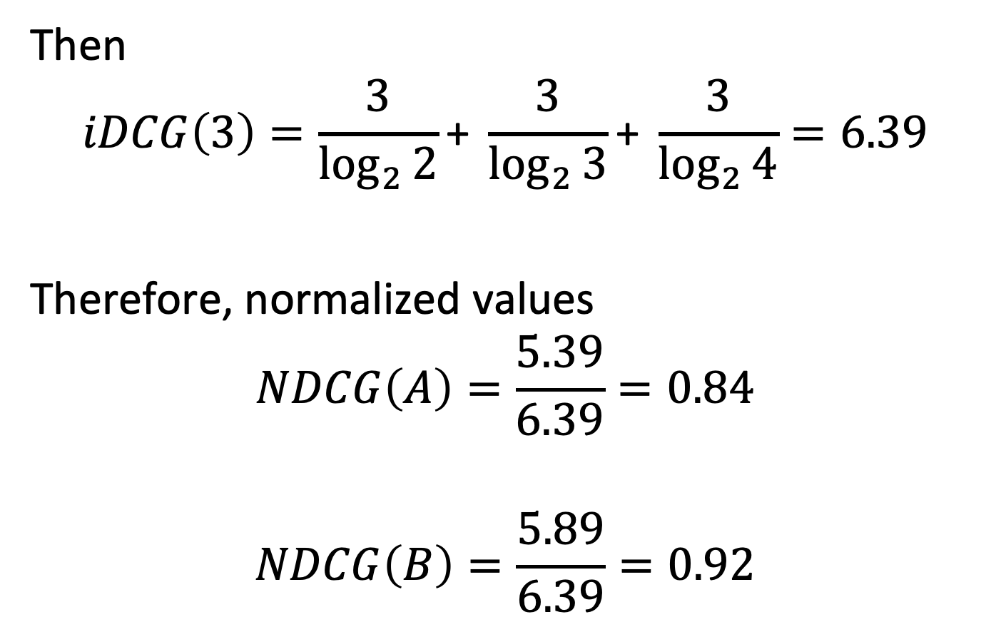
Example
Then
$$iDCG\left(3\right)=\frac{3}{\log_{2}{2}}\text{+} \frac{3}{\log_{2}{3}}\text{+} \frac{3}{\log_{2}{4}}=6.39$$
Therefore, normalized values
$$NDCG\left(A\right)=\frac{5.39}{6.39}=0.84$$
$$NDCG\left(B\right)=\frac{5.89}{6.39}=0.92$$
Notes:
In this step the DCG values are normalized.

Slide 76
Let the first four documents retrieved be R N N R. Then the MAP is
1/2
3/4
3/2
5/6

Slide 77
Let the first four documents retrieved be R N R N (scores: R = 1, N = 0) Then the DCG is
1/2
3/4
3/2
5/6

Slide 78
References
Course material based on
Ricardo Baeza-Yates, Berthier Ribeiro-Neto, Modern Information Retrieval (ACM Press Series), Addison Wesley, 1999.
Christopher D. Manning, Prabhakar Raghavan and Hinrich Schütze, Introduction to Information Retrieval, Cambridge University Press. 2008 (http://www-nlp.stanford.edu/IR-book/)
Course Information Retrieval by TU Munich (http://www.cis.lmu.de/~hs/teach/14s/ir/)
Singhal, A., Salton, G., Mitra, M., & Buckley, C. (1996). Document length normalization. Information Processing & Management, 32(5), 619-633.

